Slide 1
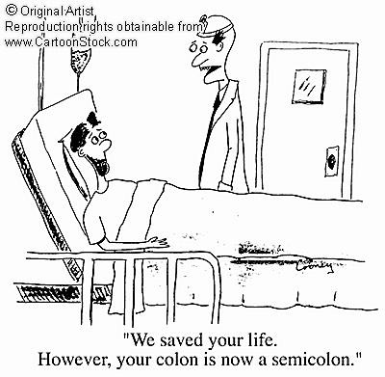
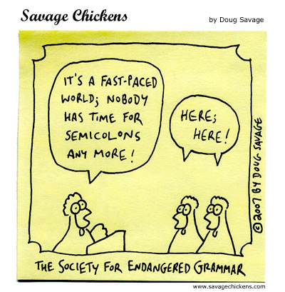
Semicolon, colon, Run-on Sentences

Slide 2
; Semicolon ;
Rule #1a: Use a semicolon to join two independent clauses that are closely related in meaning.
Examples:
1. Great writers use the semicolon; using a semicolon shows a sophisticated understanding of grammar.
2. In English class we read stories; we also read non-fiction texts.
3. I called Janet. Did you notice how windy it is? ← This sentence does not use a semicolon because the two clauses are not related in meaning.

Slide 3
; Semicolon ;
Rule #1b: Use a semicolon between independent clauses that are joined by transitions such as however, on the other hand, therefore, Similarly, additionally, or nevertheless
Examples:
1. English was John’s hardest subject; additionally, he struggled with math.
2. Mr. Hester’s ties are all very sophisticated; however, he often acts in a goofy manner.

Slide 4
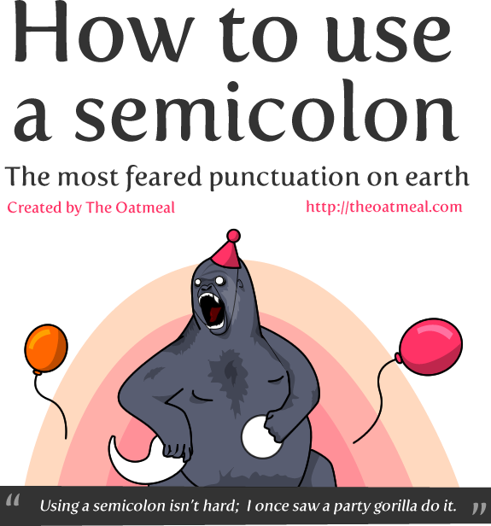
Semicolon
Warning!: Do not use a semicolon between independent clauses when they are joined by for, and, nor, but, or, yet, or so. In those cases, use a comma.
FANBOYS

Slide 5
; Semicolon ;
Rule #2: Use a semicolon in a list that uses commas as well.
Examples:
1. We visited Albany, New York; Hawthorne, California; Sacramento, California; and Las Vegas, Nevada.
2. Her favorite teachers are Mr. Hester, an English teacher; Mr. Garland, a math teacher; and Ms. Lopez, a Spanish teacher.

Slide 6
: Colon :
Rule #1: A colon is used after an independent clause and before a list that explains the previous clause.
Example 1: You absolutely need a few things to go camping: a tent, a sleeping bag, and a flashlight.
Example 2: Eynon has various hobbies: camping, mountain biking, and watching the Raiders win.

Slide 7
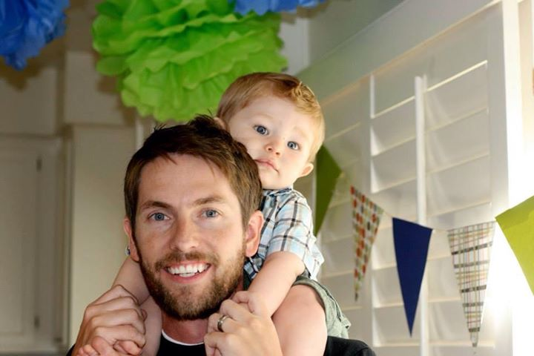
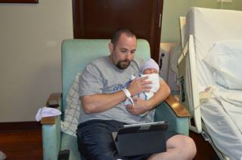
: Colon :
Wrong use: My brothers’ names: Jeff, David, and Danny.
The use of the colon above is incorrect because the first clause is not an independent clause.

Slide 8
: Colon :
Rule #2: A colon can be used before a word, phrase, or clause that explains or clarifies the previous statement.
Example with a word:
There is one thing a human being simply cannot do without: love.
Example with a phrase:
Her goal was easily stated: she wanted to win the state championships!
Example with a whole independent clause:
Luis felt that he had accomplished something good: he finished all his homework.

Slide 9
: Colon :
Wrong use: I went to the store: I bought Hot Cheetos.
The use of the colon above is incorrect because the second clause does not explain or clarify the previous clause.

Slide 10
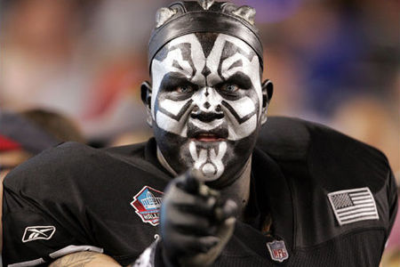
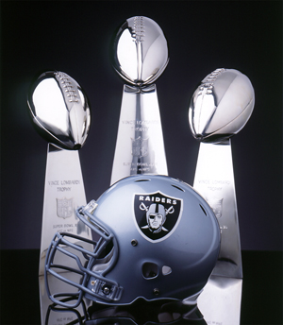
The Raiders!!!

Slide 11
Run-on Sentences (blah, blah, blah, blah, blah….)
A run-on sentence occurs when two or more independent clauses are put together without an appropriate connection.
Sometimes the appropriate connection will be a period.
Other times it will be a comma and a word from F.A.N.B.O.Y.S. (for, and, nor, but, or, yet, so).

Slide 12
Run-on Sentences
In addition, you might be able to put a semicolon between the two clauses if they are related. The only way to stop writing run-on sentences is to practice getting rid of them! So let’s practice!
Take the next 4-5 minutes to work on the practice sentences in your notes.

Slide 13
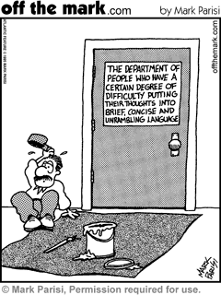
Run-on Sentences
Most of the time, people make run-ons when they squish together two independent clauses, with or without a comma. To fix these, you can do one of a few things:
What are they Mr. E?!

Slide 14
Boooom!!!
Put a comma and a FANBOYS conjunction (for, and, nor, but, or, yet, by, so) between the two clauses.
Put a period between the two clauses (don’t forget to CAPITALIZE!)
Put a semicolon between the two clauses (but ONLY if they are two closely related thoughts!)

Slide 15
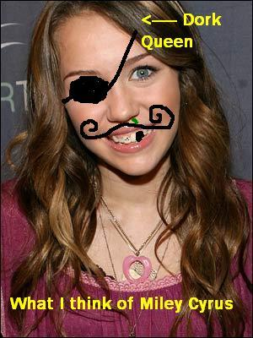
Run-on Sentence
Example:
WRONG: I can’t stand Hannah Montana, I also hate Miley Cyrus.
Right: I can’t stand Hannah Montana, and I also hate Miley Cyrus.
FANBOYS

Slide 16
More Examples! Yay!!!
Right: I can’t stand Miley Cyrus, and I also hate Hannah Montana.
Added comma and conjunction
Right: I can’t stand Miley Cyrus. I also hate Hannah Montana.
Added period (NO conjunction)
Right: I can’t stand Miley Cyrus; I also hate Hannah Montana.
Added semicolon because Hannah Montana and Miley Cyrus are closely related.

