Slide 1
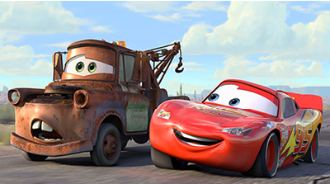
Personification and Hyperbole

Slide 2
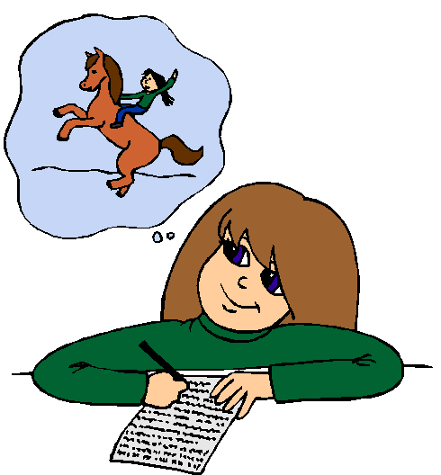
Review: Why is it important to use figurative language in our writing?
It allows the reader to visualize what the writer is saying.
It adds interest and color to a written piece

Slide 3
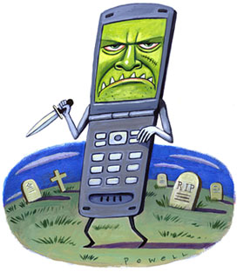
Personification
Giving human characteristics to things, animals, or ideas.
Examples: The pencil jumped out of my hand.
Fear knocked on the door. Faith answered. There was no one there.

Slide 4
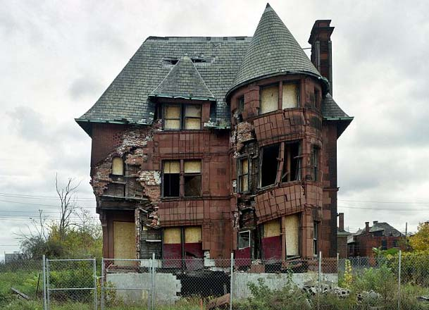
More Examples
The run down house appeared depressed.
She did not realize that opportunity was knocking at her door.
The phone awakened with a mighty ring.

Slide 5
Take 2 minutes to Think of your own examples
Hint: choose a noun and add a verb next to it.

Slide 6
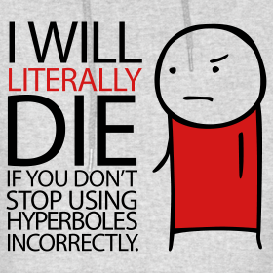
Hyperbole
*an exaggeration
*used to heighten effect. It is not used to mislead the reader, but to emphasize a point.
Example: My mom is going to kill me!
Do your parents or teachers ever exaggerate?

Slide 7
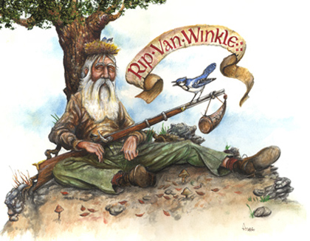
More Examples
I could sleep for a year.
This box weighs a ton.
I've told you a million times not to exaggerate.

Slide 8
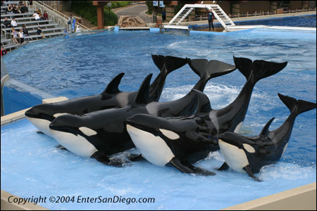
Hyperbole Example
Yo momma’s so fat, she had to go to Sea World to get baptized.
Boooooooom!
Yo Momma

