Slide 1
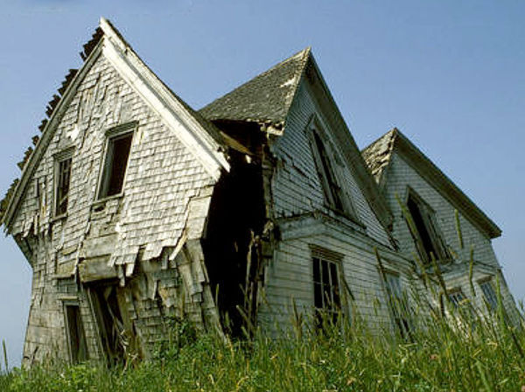
The Glass Castle
By Jeanette Walls

Slide 2
The Glass Castle: A Memoir
A collection of memories that an individual writes about moments or events that took place in their past

Slide 3
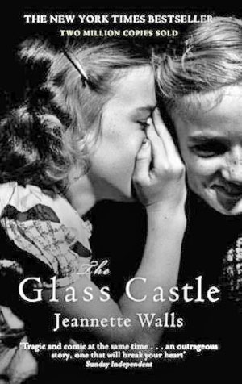
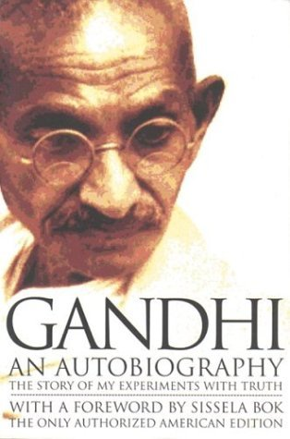
Memoir v. Autobiography A memoir is how one remembers one’s own life, while an autobiography is history, requiring research, dates, facts double checked
Memoir
Autobiography
1st person narrower focus on persons life.
1st person summarizes a life as a whole.

Slide 4
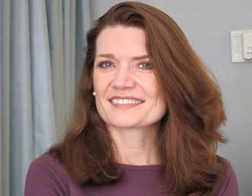
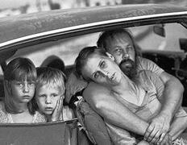
Jeanette Walls
Walls was born on April 21, 1960 in Phoenix, AZ
She lived with her family in cars and hotels for much of her childhood.
You won’t believe some of the wild events she describes in her book.

Slide 5
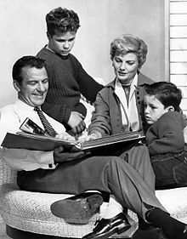
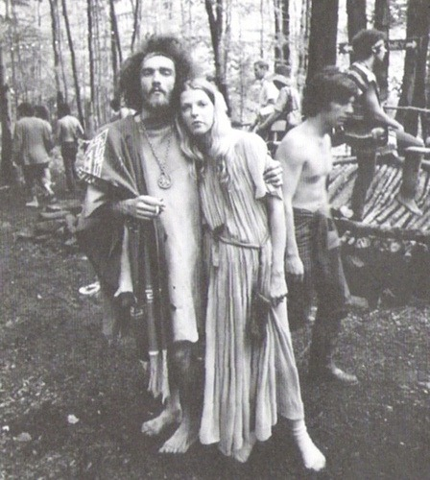
Counter Culture of 1960s
Her parents embraced 60’s and 70’s “counterculture”
Counterculture of the 1960s was identified with the rejection of social norms of the 1950s

Slide 6
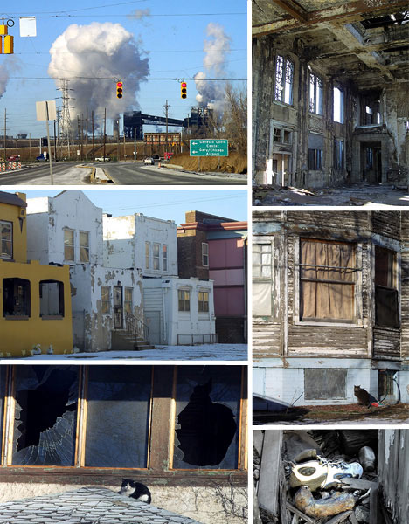
Forgotten America
Lack of education
Dependent on labor jobs
Once thriving towns, but now very poor

Slide 7
Characters
Jeanette
Rex
Main character. Independent, hardworking, passion for learning.
Jeanette’s father. Alcoholic and always borrows money. When everyone loses faith in him, Jeanette keeps faith.

Slide 8
Characters
Mary
Lori
Jeanette’s mother. Free spirit, artist, and “addict to excitement”. Sweet tooth causes family to go hungry.
Oldest child. “The smart one”. Closest with mom, but very protective of siblings.

Slide 9
Characters
Brian
Maureen
Closest with Jeanette. “The brave one”. Becomes a cop as an adult
Youngest of the family. “The pretty one”. Life goes off the rails as she gets older.

Slide 10
Themes
You need to put your own needs above others’ unrealistic goals
Overcoming obstacles can help you build a better life
Facing difficult obstacles can push you to strive for success

