Slide 1
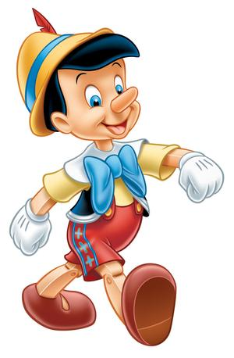
Characterization
Making the Characters Seem “Real”

Slide 2
Why Mr. E, Why?
Characterization is a crucial part of making a story compelling.
In order to interest and move readers, characters need to seem real.
Good characterization gives readers a strong sense of characters' personalities and complexities; it makes characters vivid, alive and believable.

Slide 3
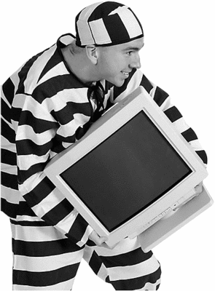
What is it Mr. E?
Characterization: the way an author shows what the characters are like.
One way to remember all the different characterization techniques authors use is the acronym STEAL.

Slide 4
S.T.E.A.L
Authors show what characters are like by describing their….
Speech
Thoughts
Effects on Others
Actions
Looks

Slide 5
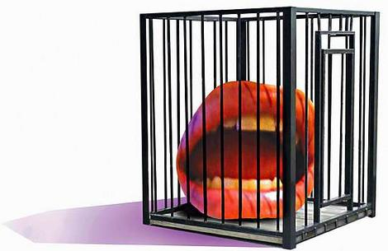
S.T.E.A.L
Speech: What the character says out loud or the way he/she speaks
Thoughts: What the character thinks—things other characters can’t hear

Slide 6
S.T.E.A.L
Effects on others: what other characters think or how they feel about the character, how they react to him/her.
Actions: what the character does.

Slide 7
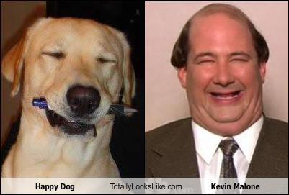
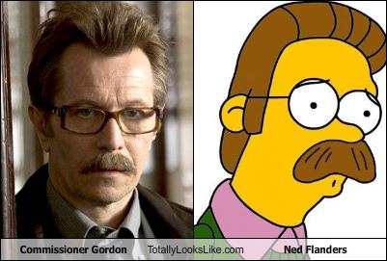
S.T.E.A.L
Looks: descriptions of the character’s face, body, clothes, etc.

Slide 8
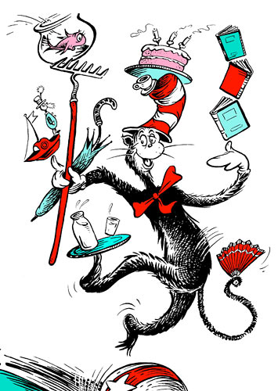
Why is the Author Telling Me This?
Always remember to think, why is the author telling me this? What does this mean about the character?
For example, in The Cat in the Hat by Dr. Seuss, one of the Cat’s actions is to balance seven objects on top of each other while standing on a ball.
What is the effect of this characterization? What do you know about the Cat?

Slide 9
Let’s try it together! Yay!
#1: Character= TJ
TJ rolled her eyes, put her hands on her hips, sighed and stomped out of the room before Sean could defend himself.
#2: Character= Kim
“No problem, sir. I’ll take care of that right away. Is there anything else that you need?” Kim responded.

Slide 10
Let’s do it again!
#3 Character= Ignatius
A green hunting cap squeezed the top of the fleshy balloon of a head. The green earflaps, full of large ears and uncut hair and the fine bristles that grew in the ears themselves, stuck out on either side like turn signals indicating two directions at once.
~ from Confederacy of Dunces by John Kennedy Toole (1)

Slide 11
Don’t stop yet Mr. E!
#4 Narrator
I am so tired of the way people look at me. I wish they would just mind their own business like I mind mine. I want to move back to California with my old friends. People here don’t know how to handle people who are different. What? Why does that girl think she can look at me like that?

Slide 12
One more time!
#5 Character: The Father
She cowered away from her father as he yelled and made sure his daughter understood that she was worthless. She always feared him and would look at other fathers and wish on every birthday candle she blew out over the years that one of them could be hers, instead of the one she was given. She could never look him in the eyes because she was scared that one gesture would make her like him, as if his eyes would become hers.

