Slide 1
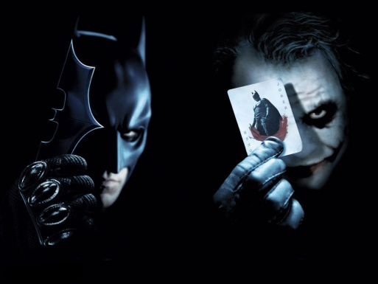
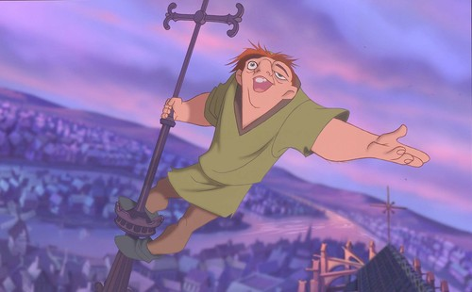
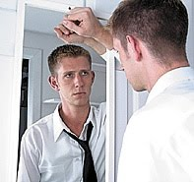
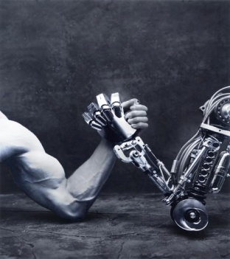
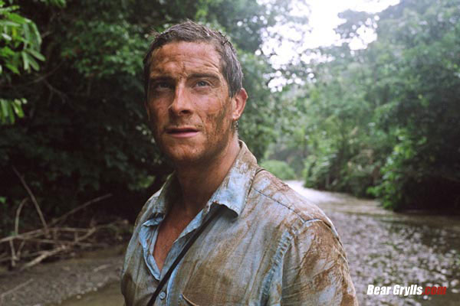
Character Motivation and Conflict
Because life’s not perfect

Slide 2
Which Movie Would You Rather See?
GIRL AND BOY:
A FATAL MISUNDERSTANDING:
Boy meets girl. They fall in love. They lived happily ever after. (1.5 hrs)
Boy meets girl. Girl has been abused and has intimacy issues. He doesn’t realize she has had a troubled past so he thinks she doesn’t like him. He becomes suicidal. Girl discovers him after he has overdosed and has enough time to tell him the truth before he dies in her arms. (1.5 hrs)

Slide 3
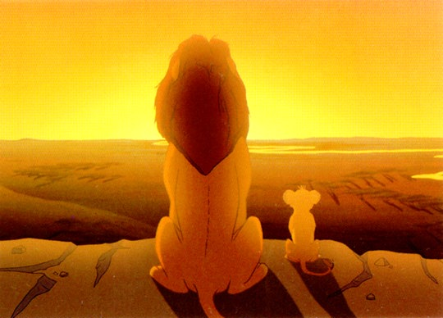
Motivation
Motivation: the reason why a character acts, feels or thinks in a certain way.
Let’s use Simba from the Lion King.
What is Simba’s motivation(s) throughout the movie?
Amir’s motivation?

Slide 4
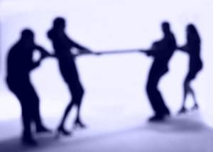
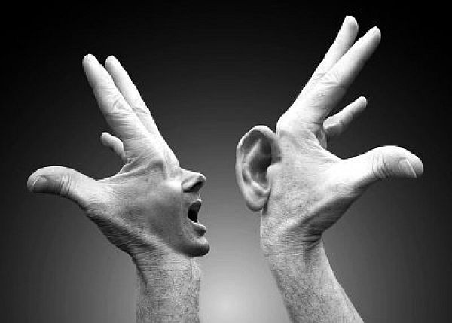
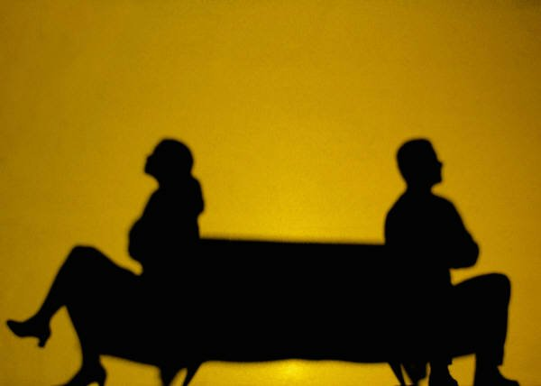
Conflict
The tension or problem in the story; a struggle between opposing forces.

Slide 5
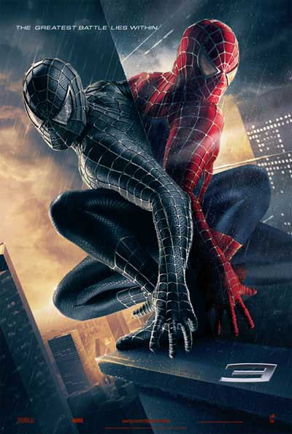
Conflict
Internal Conflict
Man vs Self
The problem or struggle that takes place in the main character’s mind
Character fighting against his own conscience or moral beliefs
Example: Spiderman has to choose whether he really wants to keep fighting crime (in fact, lots of superheroes do)
More Lion King
http://www.youtube.com/watch?v=rw45nBcWNbQ

Slide 6
External Conflict
The problem or struggle that exists between the main character and an outside force.
Man vs. Man
Man vs. society,
Man vs. nature
Man vs. Machine

Slide 7
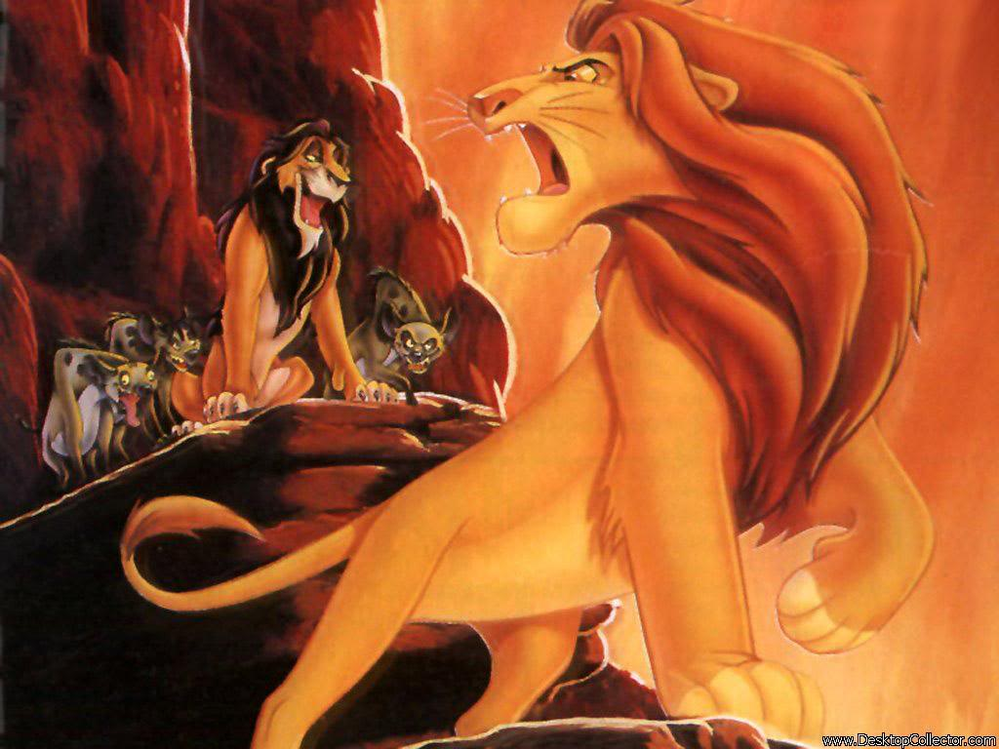
External Conflict
Man vs Man
A conflict between two people
Example: In the Lion King, Simba has a man vs man conflict with Scar.
What is an example from The Kite Runner?

Slide 8
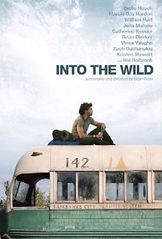
External Conflict
Man vs Society
Character who is an outcast or tries to break the normal rules of society.
Example: Hunger Games
http://www.youtube.com/watch?v=do1smOv8rf4
What is an example from The Kite Runner?

Slide 9
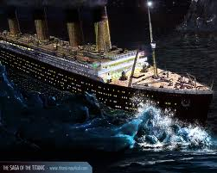
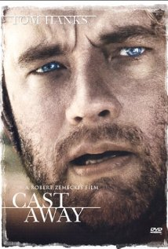
External Conflict
Man vs Nature
Character fights against forces of nature.
Example: Titanic

Slide 10
Excerpt from Titanic
Ismay: So you've not yet lit the last four boilers?
Smith: No, I don't see the need. We are making excellent time.
Ismay: The press knows the size of Titanic. Now I want them to marvel at her speed. We must give them something new to print! This maiden voyage of Titanic must make headlines!
Smith: Mr. Ismay, I would prefer not to push the engines until they've been properly run in.
Ismay: Of course, I'm just a passenger. I leave it to your good offices to decide what's best. But what a glorious end to your final crossing if we were to get to New York on Tuesday night and surprise them all! Make the morning papers. Retire with a bang, eh E.J.?
Ismay: [Smith nods reluctantly] Good man.

Slide 11
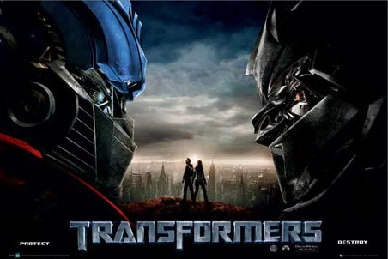
External Conflict
Man vs Machine
Character struggles against technology.
Transformers
Me trying to work my phone
Your login not working for Powerschool.

Slide 12
Name That Conflict!!!
http://www.youtube.com/watch?v=ASAat2WKS68
http://www.youtube.com/watch?v=71_p8P_PVXo
http://www.youtube.com/watch?v=SOdxz77-lag
http://www.youtube.com/watch?v=l6fSns12XmE

