Slide 1
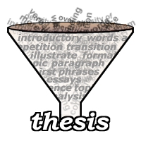
Thesis Statement
Yay!!!

Slide 2
Why Mr. E, Why?
A thesis statement allows you to better organize and develop your argument.
It provides your reader with a “guide” to your argument.
It’s the one sentence that tells the reader what the whole paper is about.

Slide 3
Now we know why a thesis is important, but what is it Mr. E?!
Great Question?
A thesis statement presents your 1)opinions or thoughts on a subject or an issue. You cannot write an essay without one.
A thesis statement must contain a 2)subject + an opinion
A thesis statement 3)answers the topic question/prompt

Slide 4
What makes a GOOD thesis statement, Mr. E?
1) simple: it should be no longer than one sentence, regardless of essay length.
2) Limited to one main idea
3) Does not use loaded language (emotionally charged language).
4) A declarative sentence with no qualifiers
Might, maybe, perhaps, etc.

Slide 5
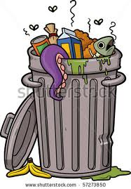
Never Use…
A thesis statement should NEVER contain the following:
in my opinion
I think
I believe
If you put any of these in your thesis statement, I will throw it in the trash!!!

Slide 6
Thesis Statement
Do’s
Don’ts
Subject + your opinion
One main idea
Addresses prompt
Declarative
One sentence
Last sentence of intro. paragraph
In my opinion, I think, I believe, etc.
Maybe, might, perhaps, etc.
This paper will be about…
A question

Slide 7
What, How, or Why
If your reader ever has to ask what, how, or why after reading your thesis statement, then you will have to improve it.
Bad Examples:
Many people object to today’s violent horror movies.
(Why? What do they object to? Why should we care?)
Shakespeare’s Midsummer’s Night Dream is his greatest play because it is so complicated.
(How is it complicated? Why does that make it so great?)

Slide 8
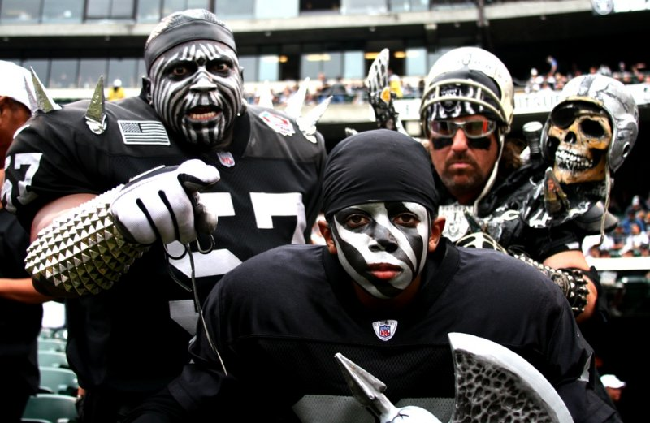
Good thesis or bad thesis?
With a rich history that promotes a commitment to excellence, the Oakland Raiders are the greatest NFL team of all time.
Booooooooom!

Slide 9
Da Raiders!!!!
If I was writing a research paper on the Raiders, this would be a good thesis.

Slide 10
Crucible Examples
Due to the mindset change of Salem and eventually the province of Massachusetts, John Proctor’s decision to be hanged was a heroic decision that left a positive impact on society.
Or
John Proctor’s heroic decision to be hanged changed the mindset of a broken Salem and left an everlasting impact on society.

Slide 11
Let’s break this down
John Proctor’s heroic decision to be hanged changed the mindset of a broken Salem and left an everlasting impact on society.
What: John Proctor made the correct decision to be hanged.
Why: Left an everlasting impact on society.
How: Changed the mindset of the people

