Slide 1
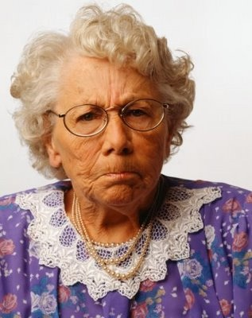
Syntax, Diction, Tone, Mood

Slide 2
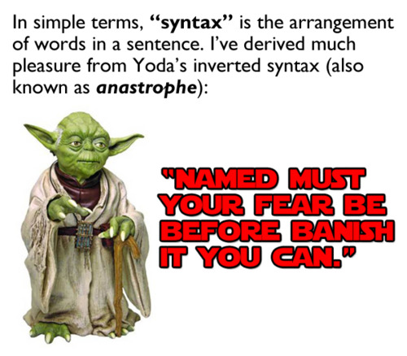
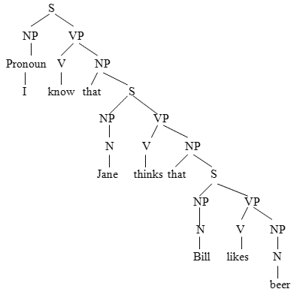
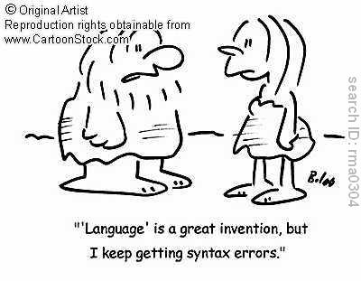
Syntax
Syntax is how words are sequenced to convey meaning.
This meaning can be changed by rearranging the same words in a different order (e.g. 'I can run fast' changes to 'Can I run fast?').

Slide 3
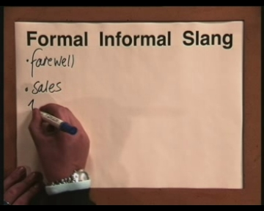
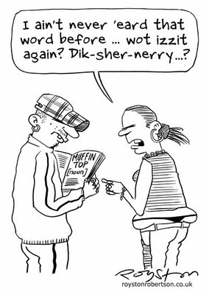
Diction
writer’s choice of words and phrases.
Types of Diction:
Formal, informal, simple, poetic, monosyllabic, polysyllabic, elevated, etc.
Diction will be effective only when the words you choose are appropriate for the audience and purpose, when they convey your message accurately and comfortably.

Slide 4
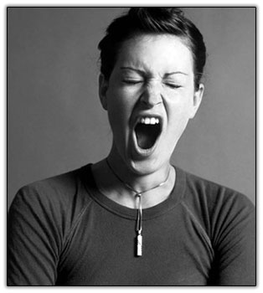
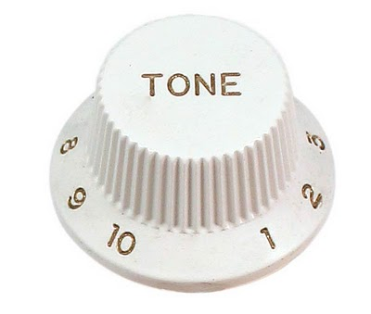
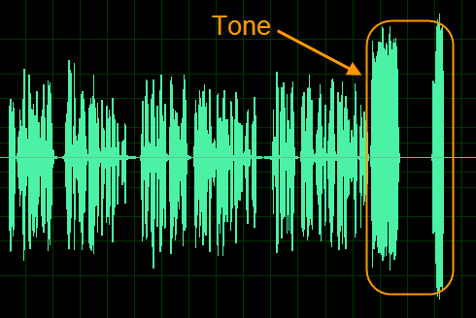
Tone
The attitude of the author toward what he or she is writing about.
Judgmental, cynical, sarcastic, sentimental, nostalgic, angry, bitter
Distinguish author from speaker

Slide 5
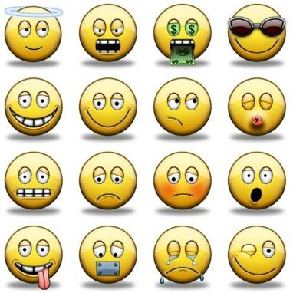
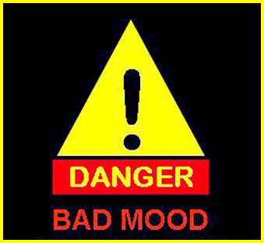
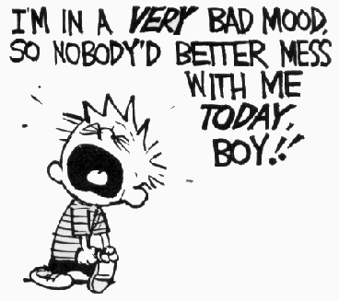
Mood
The atmosphere or emotional condition created by the piece.
Mood refers to the general sense or feeling which the reader is supposed to get from the text.
Mood does NOT refer to the mood of a character or the author

