Slide 1
The Kite Runner
By Khaled Hosseini

Slide 2
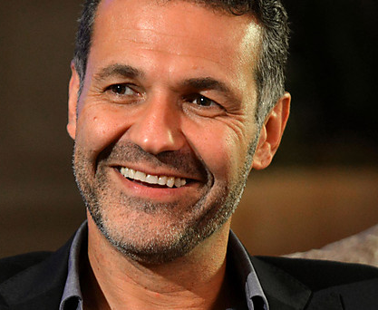
Khaled Hosseini
Born: March 4, 1965
Kabul, Afghanistan
Father was diplomat and mother was a teacher.
Moved to France at age 11 and never able to return to Kabul due to Soviet War.
Family was given asylum in U.S. and moved to California.
Didn’t return to Afghanistan until he was 38 years old.
Went to medical school and became doctor for 10 years.
Quit when the Kite Runner became a success… He gone!!!

Slide 3
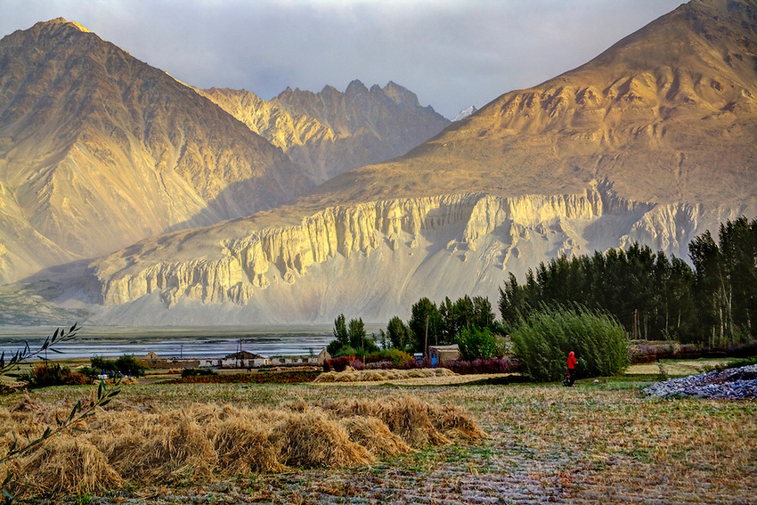
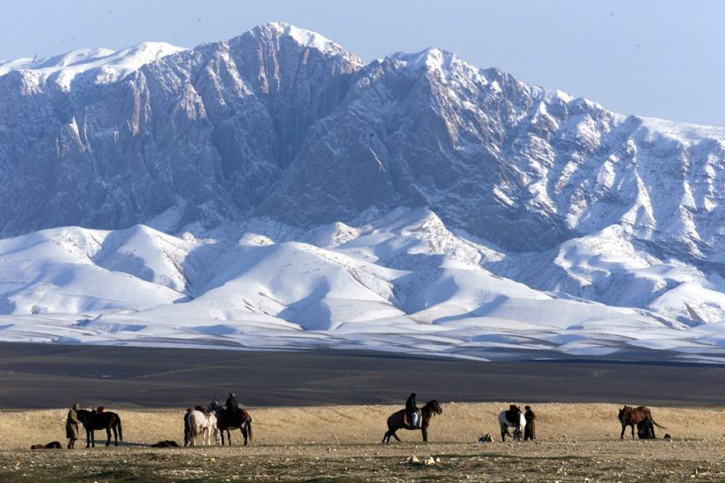
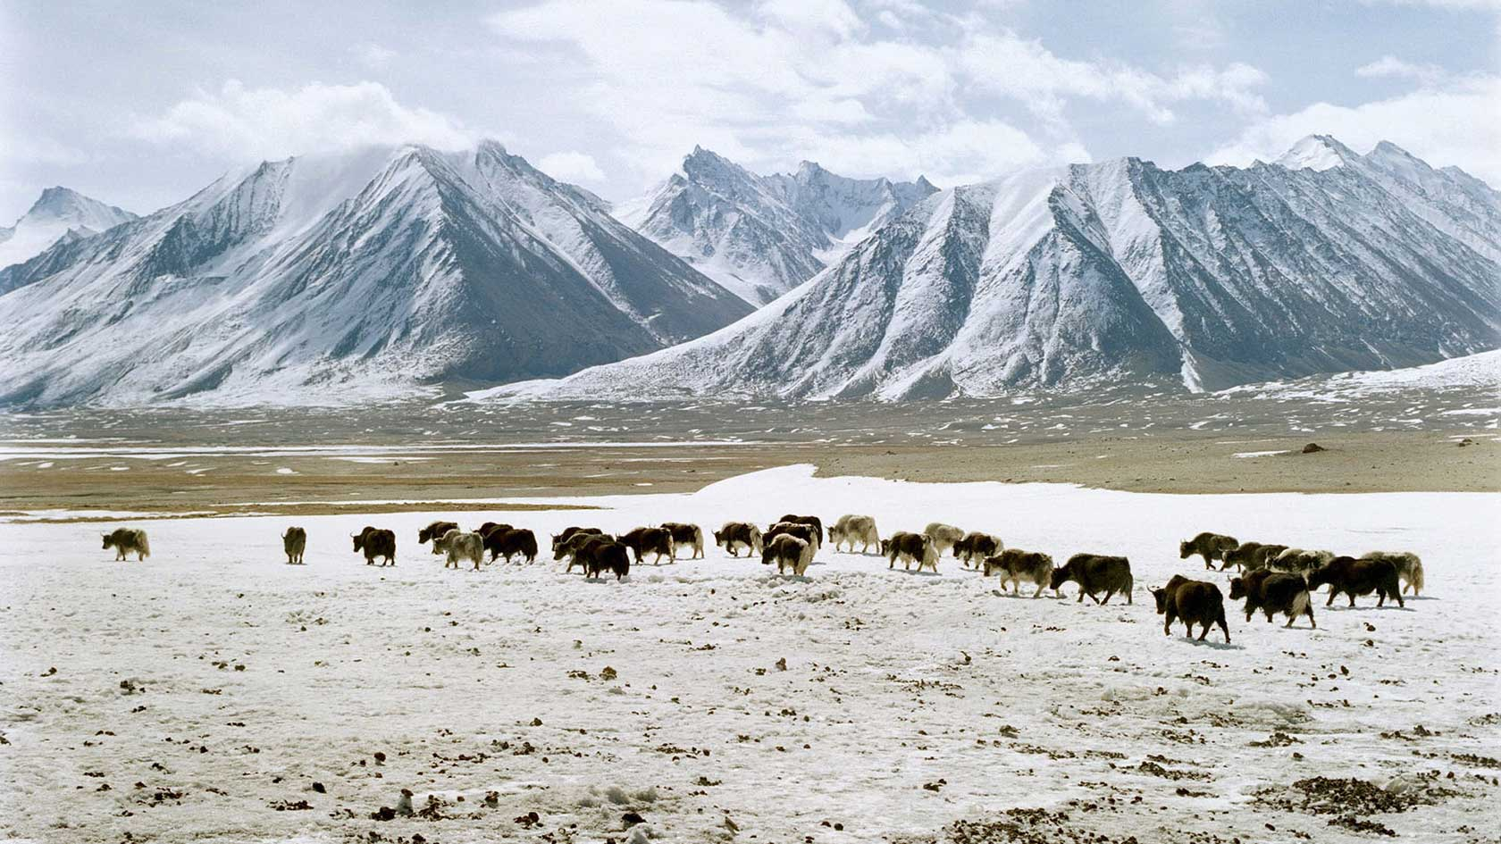
Hosseini’s Intention
Hosseini ‘wanted to write about Afghanistan before the Soviet war because that is largely a forgotten period in modern Afghan history. For many people in the west, Afghanistan is synonymous with the Soviet war and the Taliban.’ He explains: ‘I wanted to remind people that Afghans had managed to live in peaceful anonymity for decades, that the history of the Afghans in the twentieth century has been largely peaceful and harmonious.’ (Newsline Publications 2001 in Sherman 2006, p. 5)

Slide 4
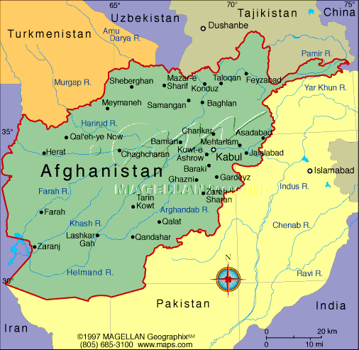
Afghanistan
Ethnically diverse country.
As of July 2007, there were approx. 32 million people.
About 99% of the population is Muslim, and of these Muslims, 84% belong to the Sunni sect.
Many ethnic groups have not had a strong voice within the society.

Slide 5
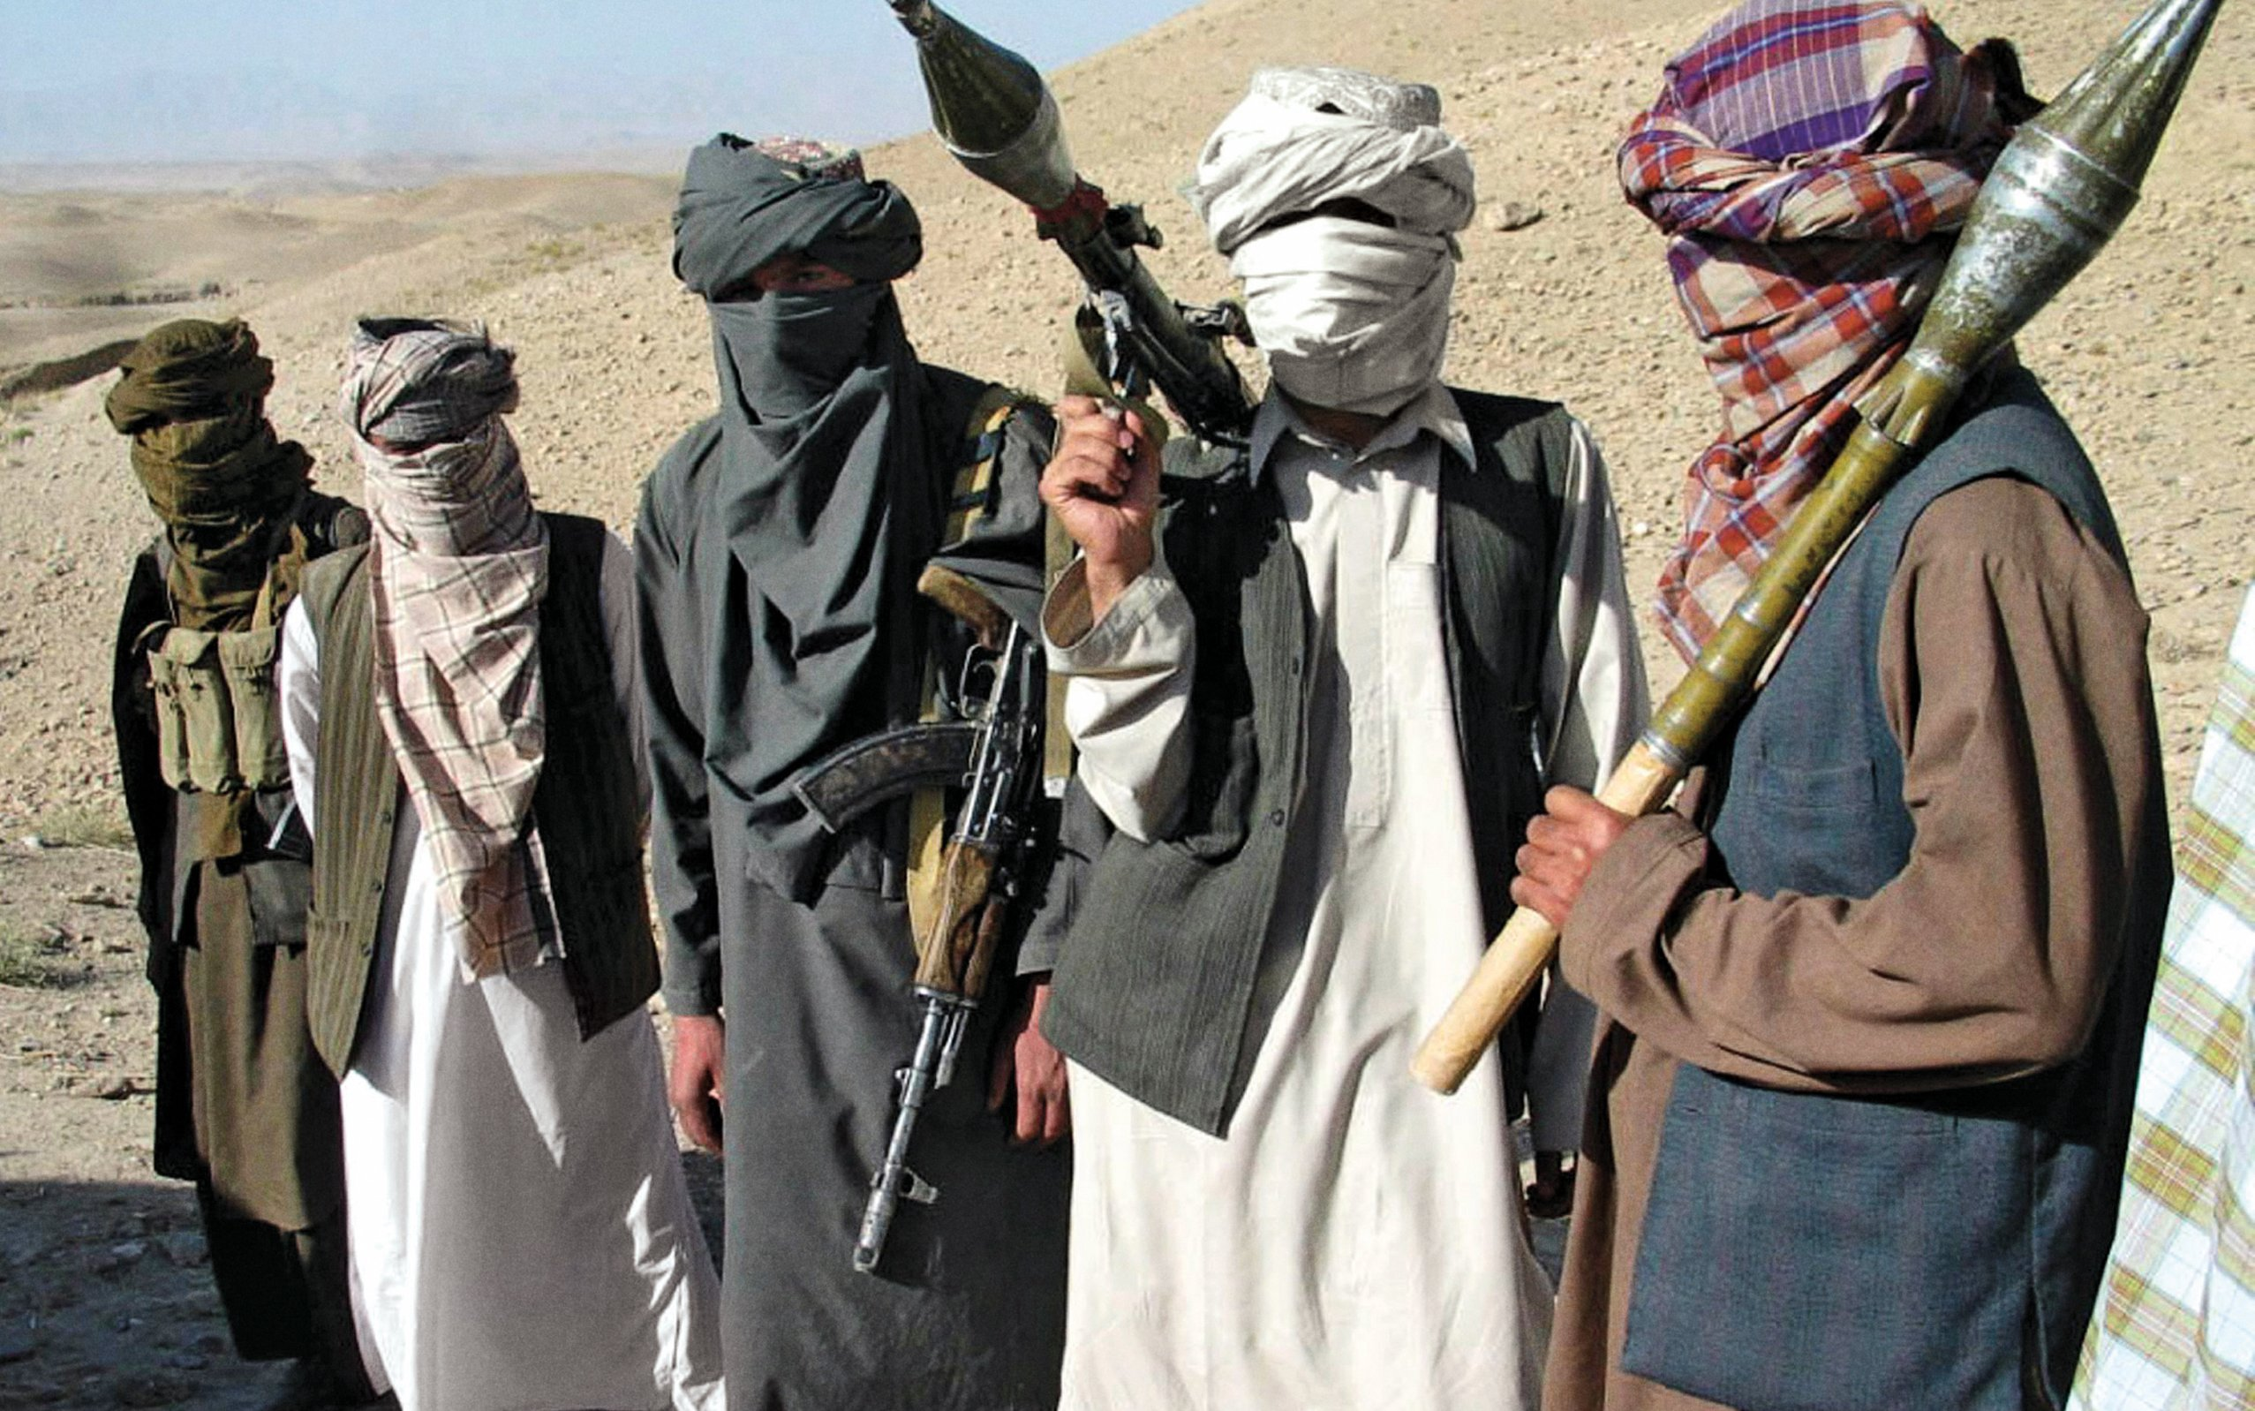
The Taliban
1996 – Taliban seized control of Kabul and introduce hardline version of Islam.
They were the sons of Afghan refugees in Pakistan and
attended Pakistani schools of theology

Slide 6
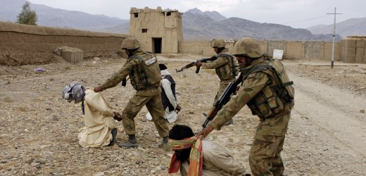
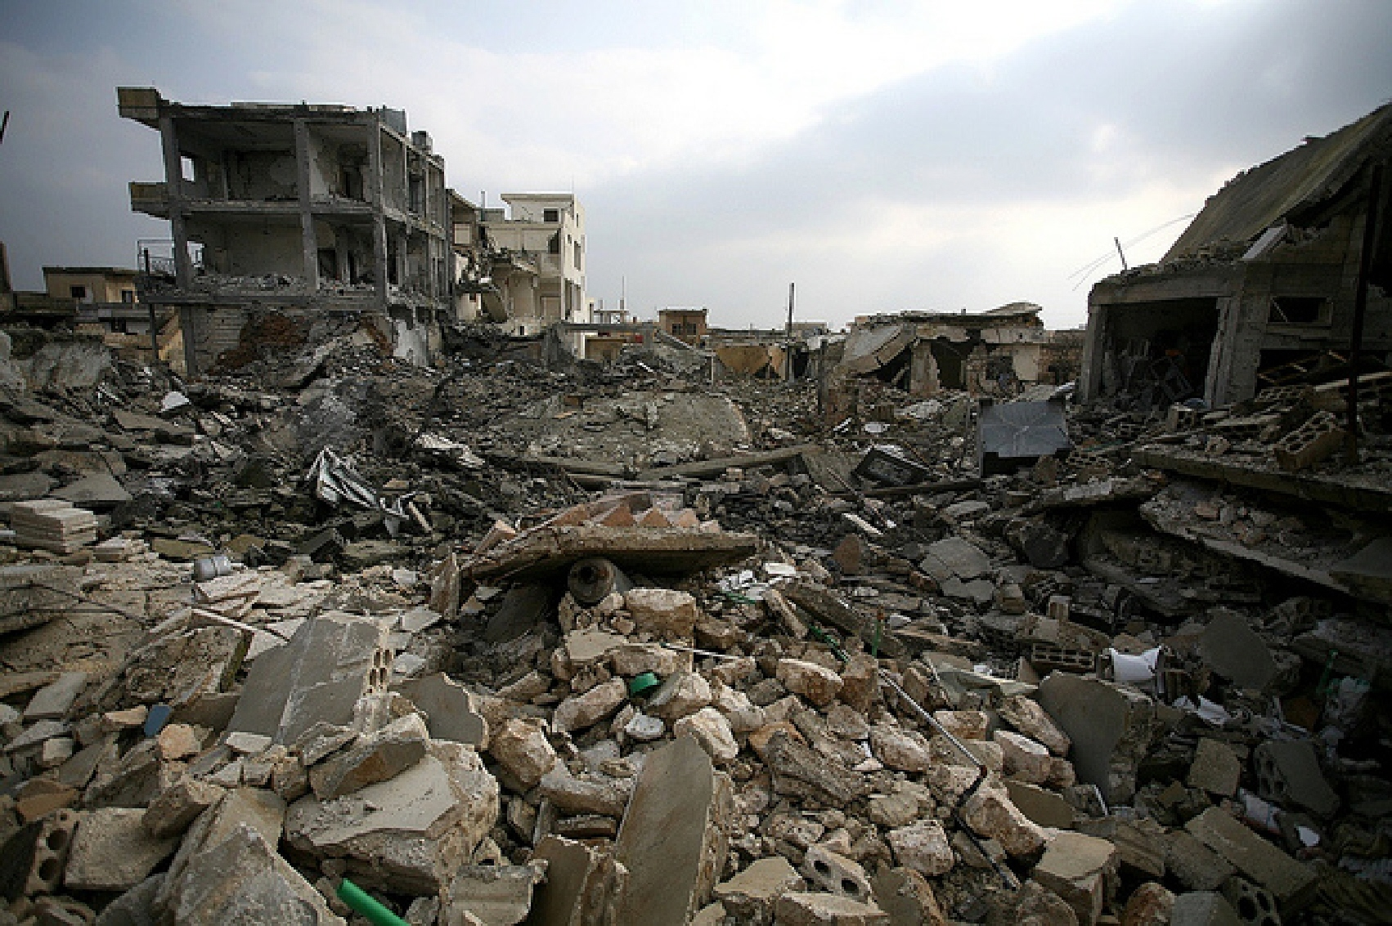
Taliban and the World
Only three countries recognized the Taliban government:
Saudi Arabia, the United Arab Emirates, and Pakistan
The Cold War, between the U.S.A. and the
former Soviet Union brought death and utter destruction to
the country.
Over 5 million Afghans abandoned their homes and went
into exile in other countries.
Close to 1.5 million lost their lives
Many left their homes for secured areas of the country.

Slide 7
Taliban Rules
Complete ban on women's work outside the home
Complete ban on women's activity outside the home unless accompanied by a male
Ban on women studying at schools
No Dancing or listening to music
No internet
No TV
No laughing in public
No flying kites
Women not allowed to have photograph taken

Slide 8
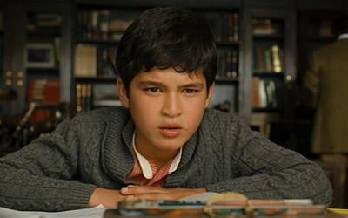
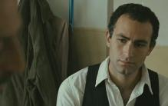
Amir
He is protagonist and narrator of the novel, a wealthy boy who grows up in Kabul, Afghanistan along with his father, Baba. Amir abuses his privileges over his servant and loyal friend, Hassan, and then fails to come to his aid. The rest of the novel deals with Amir’s guilt, his growing maturity (as he and Baba move to the U.S.), and his quest for redemption.

Slide 9
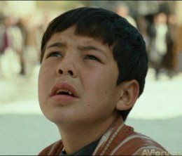
Hassan
Amir’s childhood playmate and companion, a Hazara boy with a cleft lip. Hassan is an excellent kite runner, and is naturally intelligent, but illiterate because of his social class. He is always loyal to Amir, even when Amir betrays him. Hassan eventually marries Farzana, and has a son named Sohrab.

Slide 10
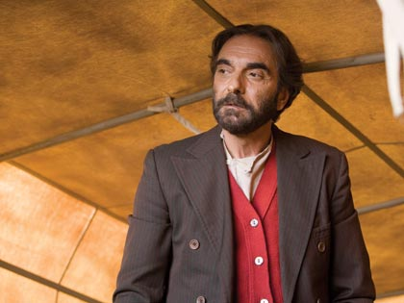
Baba
Amir’s father, a larger-than-life figure with wild hair and a loud voice, who works hard and succeeds at all of his endeavors, but stands by his strict moral principles. Baba has a huge secret. Baba’s many works of charity and the orphanage he builds are part of his attempts to redeem himself.

Slide 11
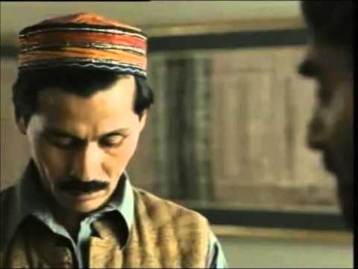
Ali
Hassan’s father, a Hazara who was orphaned as a boy and then taken in by Baba’s father and raised as Baba’s playmate and servant. The lower half of Ali’s face is paralyzed, and he was crippled in one leg by polio, but Ali remains cheerful and kind.

Slide 12
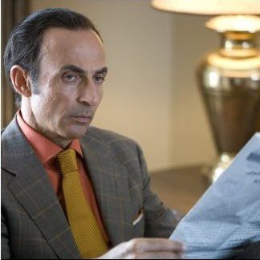
Rahim Khan
Baba’s close friend and business associate, a kind man who often seems to understand young Amir better than Baba. Rahim Khan encourages Amir’s writing, and as an old man he summons Amir back to Afghanistan for a chance to redeem himself.

Slide 13
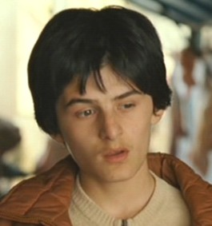
Assef
The antagonist of the novel, a blue-eyed, sadistic boy who idolizes Hitler, torments children with his brass knuckles, and does something horrific. As an adult Assef joins the Taliban.

Slide 14
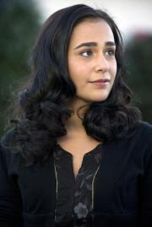
Soraya
The daughter of General Taheri. As a young woman Soraya ran away with an Afghan man, “dishonoring” herself. Amir falls in love with her and they get married, and Soraya later becomes a teacher.

Slide 15
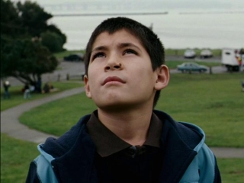
Sohrab
Hassan’s son. We meet him later in the novel as Amir ventures back to Afghanistan.

