Slide 1
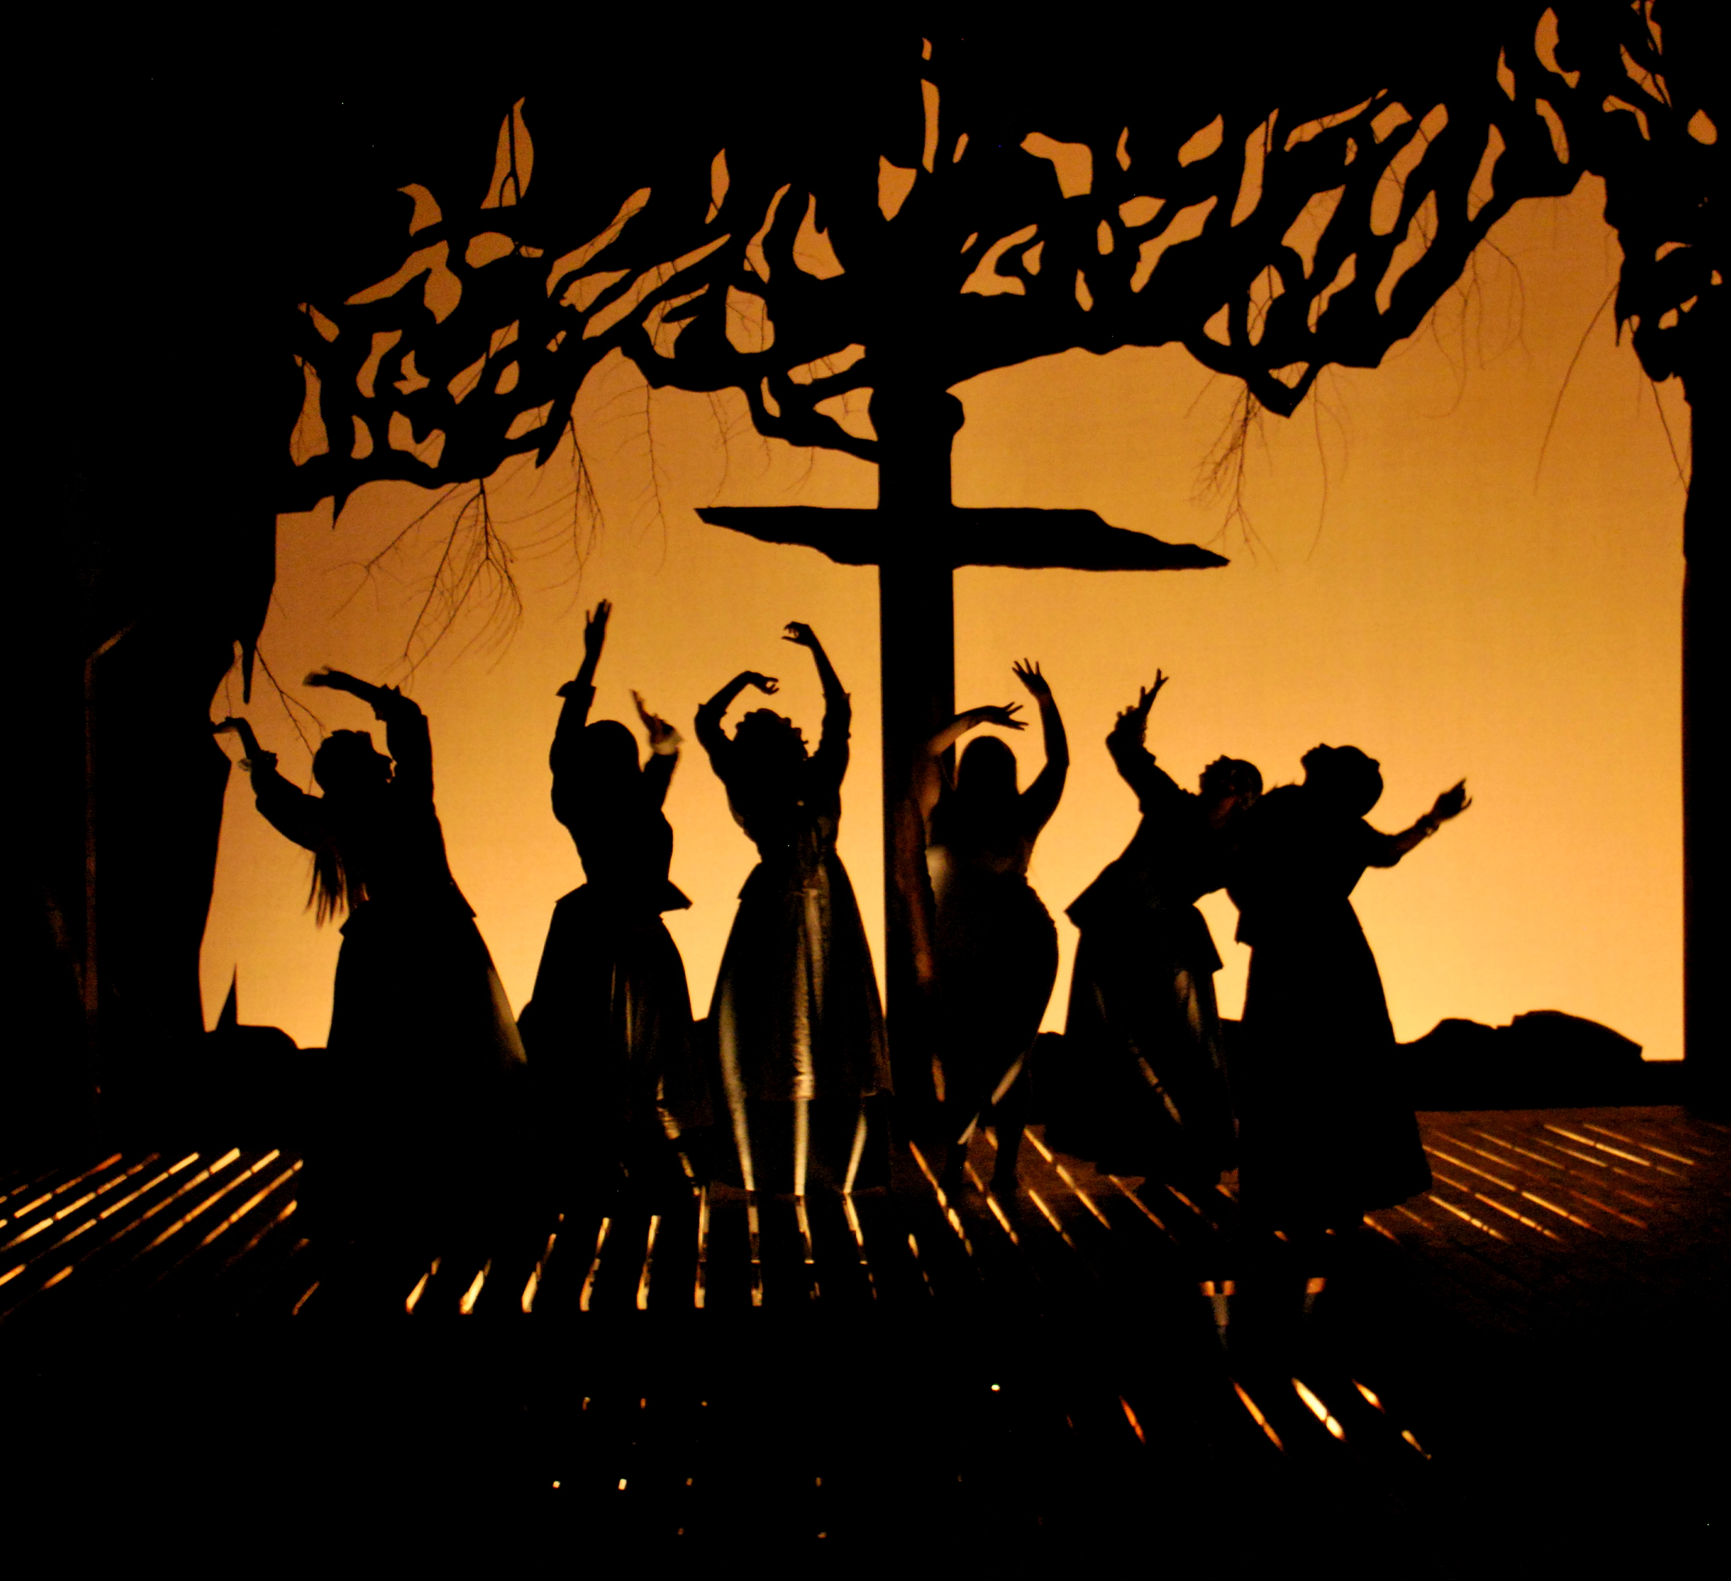
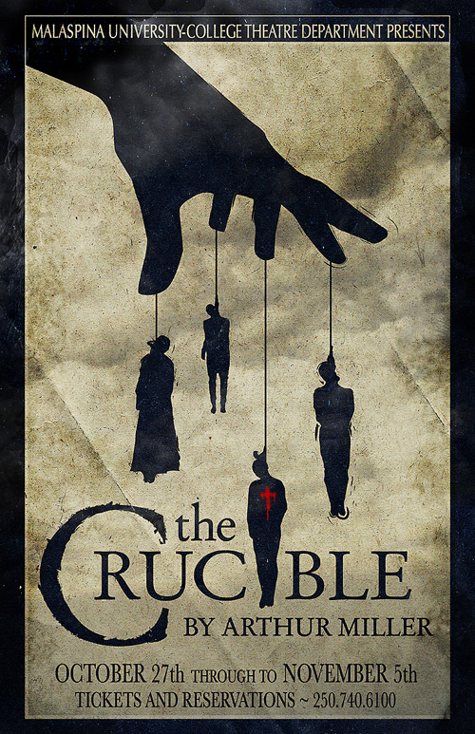
The Crucible
By Arthur Miller

Slide 2
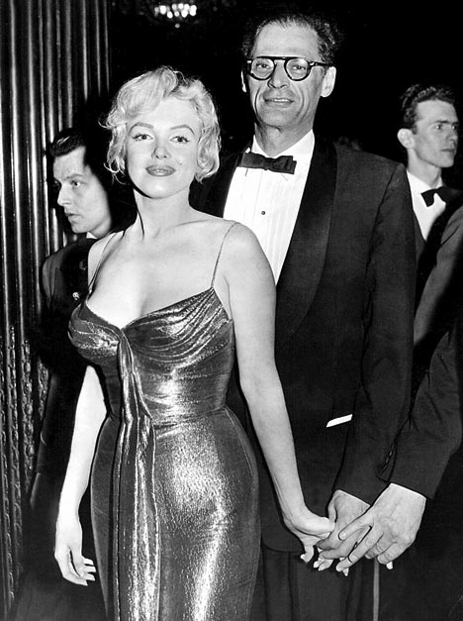
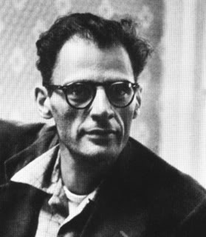
Arthur Miller 1915-2005
Married to Marilyn Monroe!
Total Stud!
Father was successful business owner, but lost everything during the great depression.
Depression had a profound impact on the development of his social consciousness.
Miller condemned the American ideal of prosperity on the grounds that few can pursue it without making dangerous moral compromises.

Slide 3
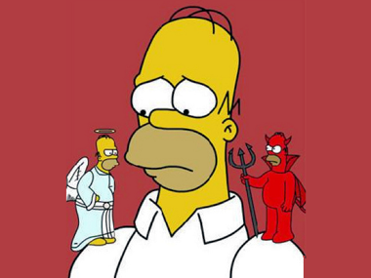
Arthur Miller
Let’s take a closer look at this quote.
In your guided notes, analyze and put in to your own words what this particular quote means.
Discuss with your table.
Miller condemned the American ideal of prosperity on the grounds that few can pursue it without making dangerous moral compromises.

Slide 4
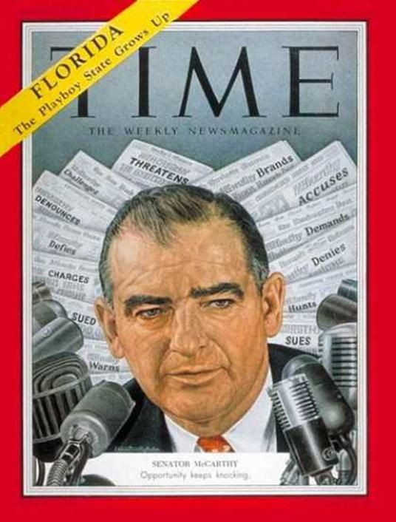
Miller’s inspiration for The Crucible
The Red Scare (Communism)
McCarthyism
Shortly after the end of World War I, a “Red Scare” took hold of the nation. Named after the red flag of the USSR (now Russia), the “Reds” were seen as a threat to the democracy of the United States.
Fear, paranoia, and hysteria gripped the nation, and many innocent people were questioned and then jailed for expressing any view which was seen as anti-Democratic or anti-American.
Senator Joseph McCarthy conducted Senate hearings that were supposed to flush out suspected communists from government and other areas of American life, including the Arts.
The “liberal” entertainment industry was a major target.

Slide 5
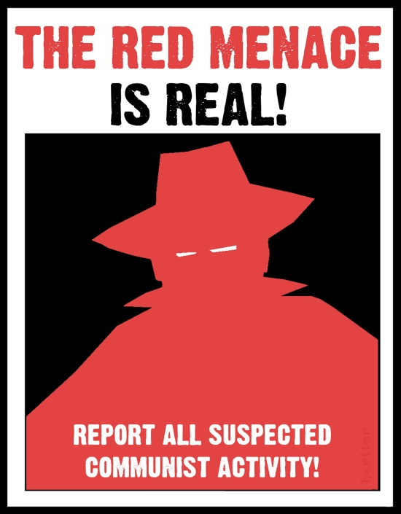
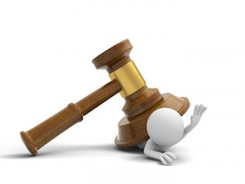
Strategy of McCarthyism
Scare people in to false confessions, attempting to save themselves.
This would create the image that the U.S. was overrun with Communists, and perpetuating the hysteria.
They would then force these people to submit a false list of names of other individuals who were “associated” with the communist party.

Slide 6
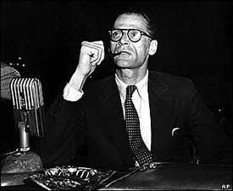
The Effect on Miller
Miller was asked to testify, but refused to admit any wrong doing as well as point fingers (give list of names).
Over 300 entertainers were placed on a blacklist for possible communist views and were thus forbidden to work for major Hollywood studios (many of these were writers).
Arthur Miller was one of those blacklisted.

Slide 7
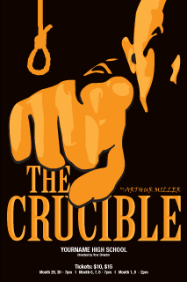
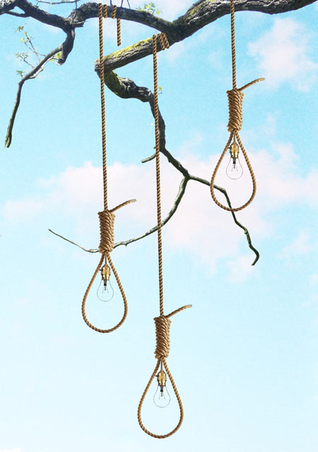
So He Wrote a Play

Slide 8
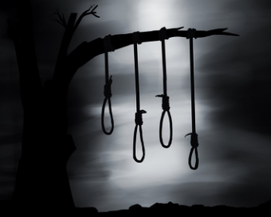
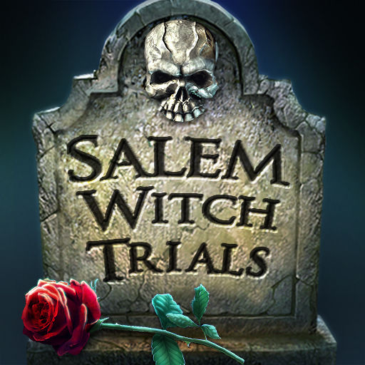
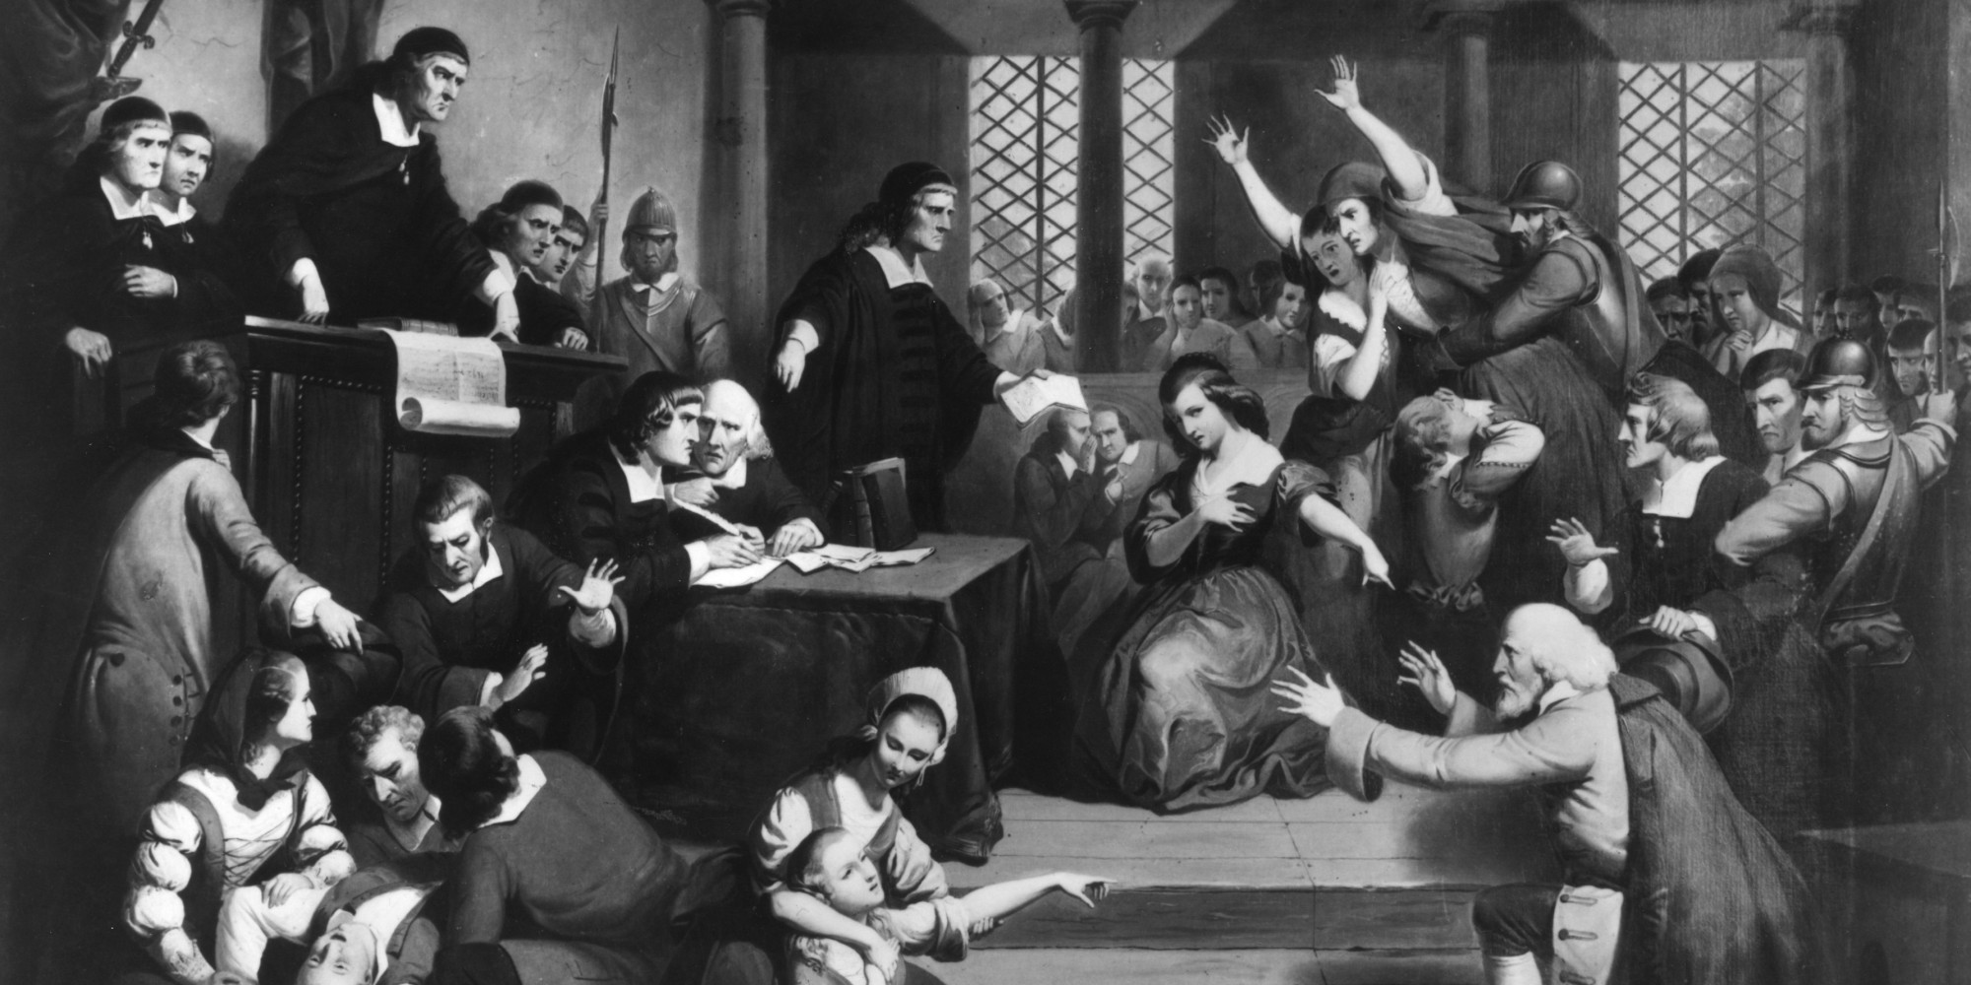
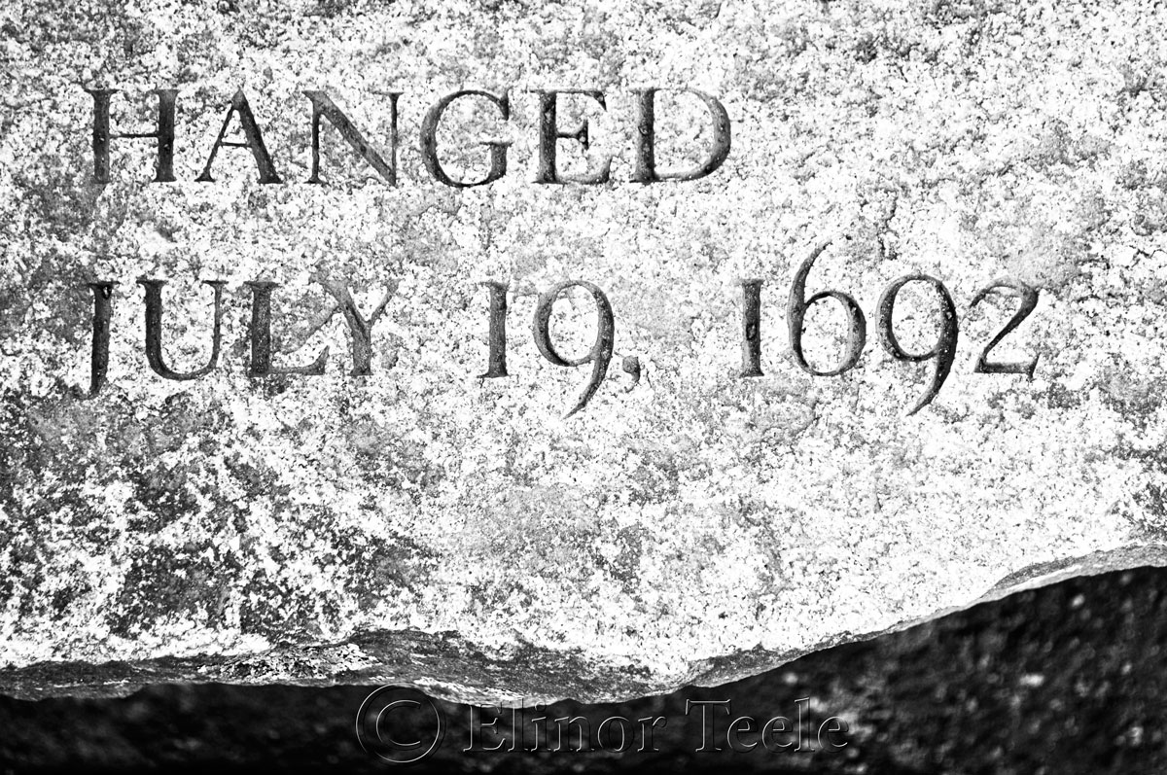
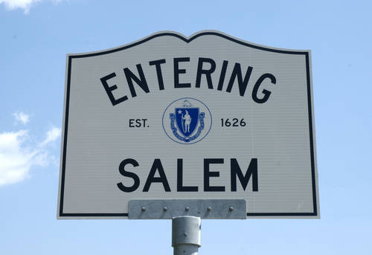
Salem Witch Trials… No Joke!

Slide 9
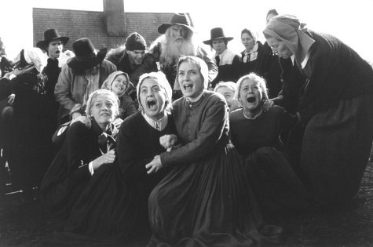
Salem, Massachusetts, 1692
Early in 1692, a small group of girls in Salem fell ill, falling victim to hallucinations and seizures.

Slide 10
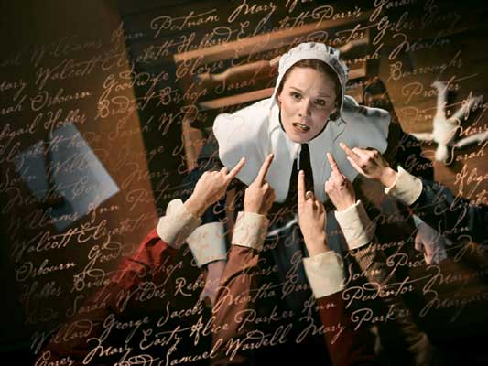
In extremely religious Puritan New England, frightening or surprising occurrences were often attributed to the devil or his cohorts.
The unfathomable sickness spurred fears of witchcraft, and it was not long until the girls, and many other residents of Salem, began to accuse other villagers of consorting with the devil and casting spells.
Seriously, this actually happened! You can’t make this stuff up!

Slide 11
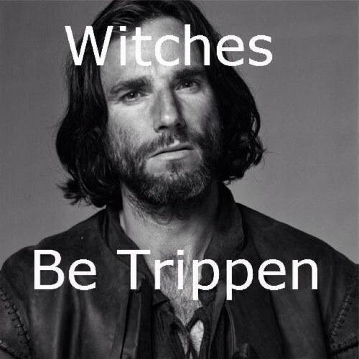
I wish I was making this up!
Within a few weeks, dozens of people were in jail on charges of witchcraft. The hysteria lasted from May to September of 1692. By the time it was over, 19 people (and two dogs) had been convicted and hanged for witchcraft, one elderly man was pressed to death by stones, and 150 prisoners were awaiting trial. Five more people died in prison.

Slide 12
Parallels, anyone?
Discuss with your table the parallels of Miller’s experience with the Red Scare and the Salem Witch Trials

Slide 13
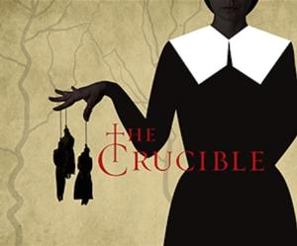
The Crucible
The play is a parable for the McCarthy era, in which similar “witch hunts” occurred targeting citizens as communists rather than disciples of the devil.

Slide 14
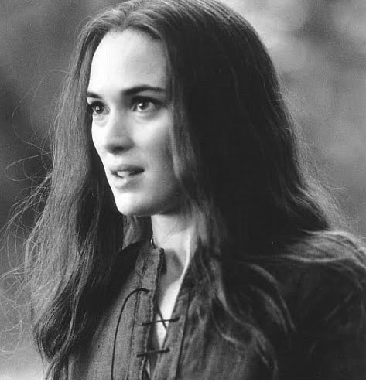
Abigail Williams
An orphan and Rev. Parris' 19-year-old niece. She leads the other girls in the accusations. She has recently been fired from the service of the Proctors after Elizabeth discovers she and Proctor were having an affair.

Slide 15
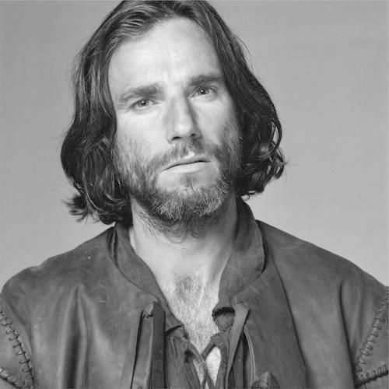
John Proctor
He is outspoken and well respected. He has stopped going to church and wrestles with telling the truth or protecting his wife Elizabeth.

Slide 16
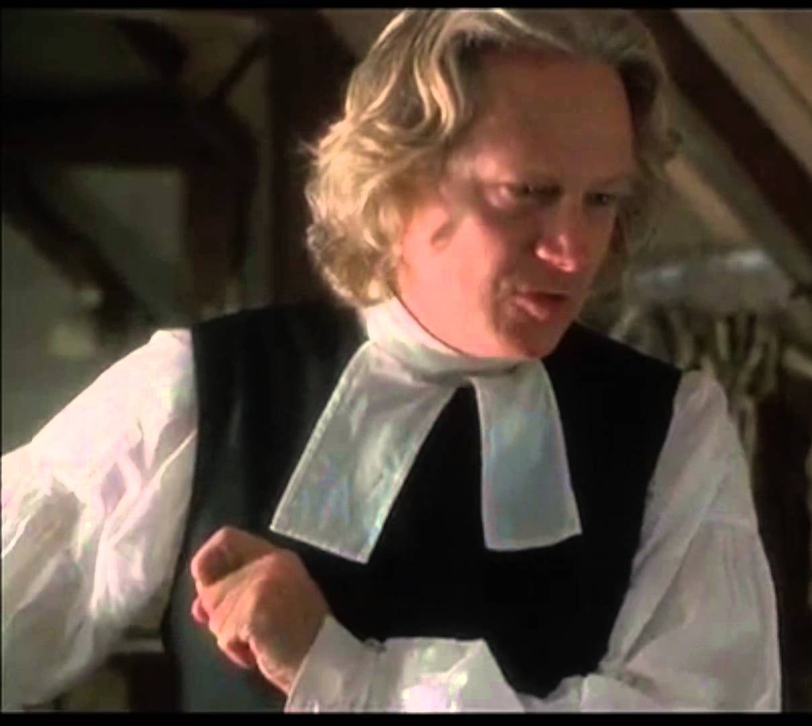
Reverend Samuel Parris
Salem’s minister who has not found popularity in the small town, especially with John Proctor.

Slide 17
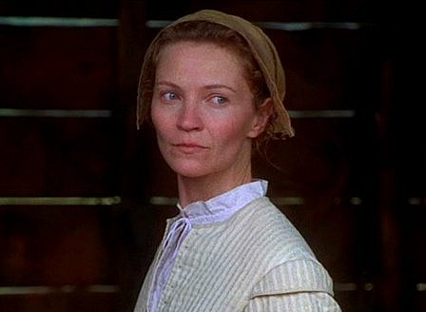
Elizabeth Proctor
John's wife who has discovered his affair. She is a virtuous woman but struggles to show Proctor affection after her discovery.

Slide 18
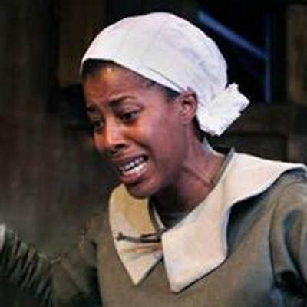
Tituba
Rev. Parris' slave from Barbados who has taught the girls about spirits.

Slide 19
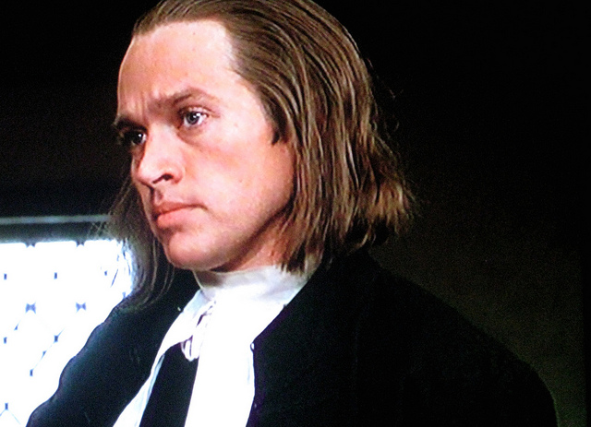
Reverend Hale
A self appointed expert on witchcraft, he is the minister who is first called in to investigate the happenings in Salem.

Slide 20
Thomas Putman
A mean spirited and wealthy landowner who covets his neighbors' property. He is accused of coercing his daughter to accuse people in order to gain their land.

