Slide 1
Intro To DVC Journalism

Slide 2
What Will we be doing?
As a news team, we will create our own news publication.
Each person on our news team will be a journalist and will compose an article for each edition.
We will be given the opportunity to write an Op-Ed, Feature, or Hard News article.
There will be a few options for you to choose
For each edition, you will have to come up with a topic/subject and give a pitch of your angle to your editors.
We will run through the same cycle for every news edition.

Slide 3
1) Why is journalism important for our society? 2) In what ways can journalism negatively affect society?
Driving Questions

Slide 4
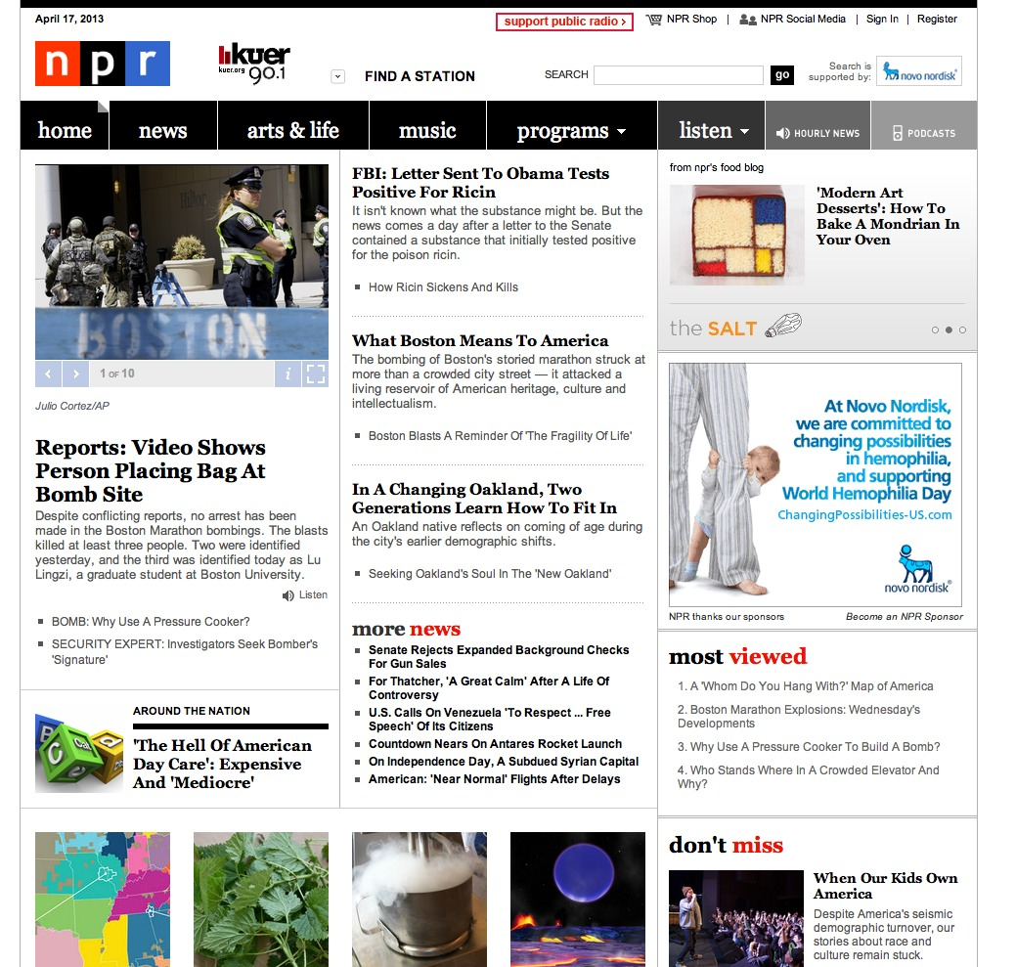
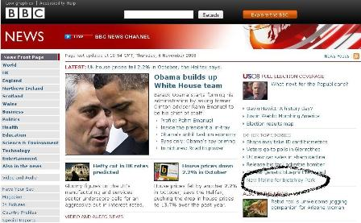
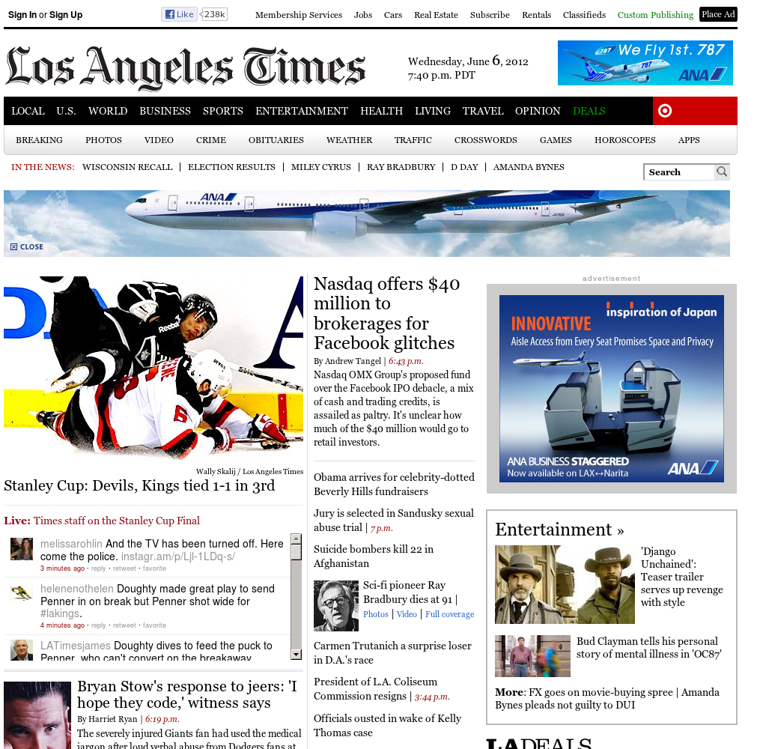
Final Publication
As a News team, we will design an online publication in which we launch each edition consisting of each article written by your group members.
Additionally, each article must contain a photo that relates to your article.
You want to catch the readers attention!

Slide 5
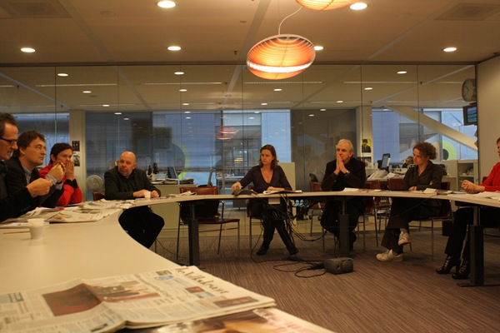
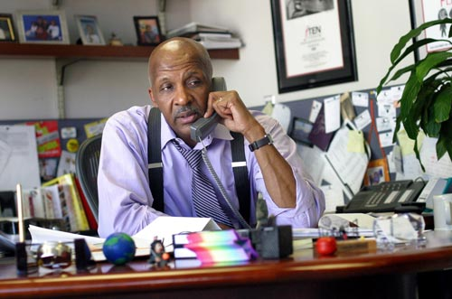
Positions
Editor-in-Chief
Boss/leader of news team.
Provide feedback to journalists.
Responsibility to review all articles and give go-ahead to publish.
Requires lots of editing
Final approval before publication
Asst. Editor-in-Chief
2nd in command
Assist the Editor in the above duties
Assists journalists composing their pitches.
Requires lots of editing
Director of Webpage
Architect of webpage
Collaborates with Editors on vision of webpage.
Responsible for the public image of news team and organization.
Uploads articles for each edition

Slide 6
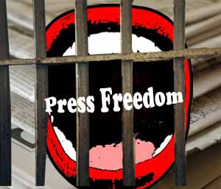
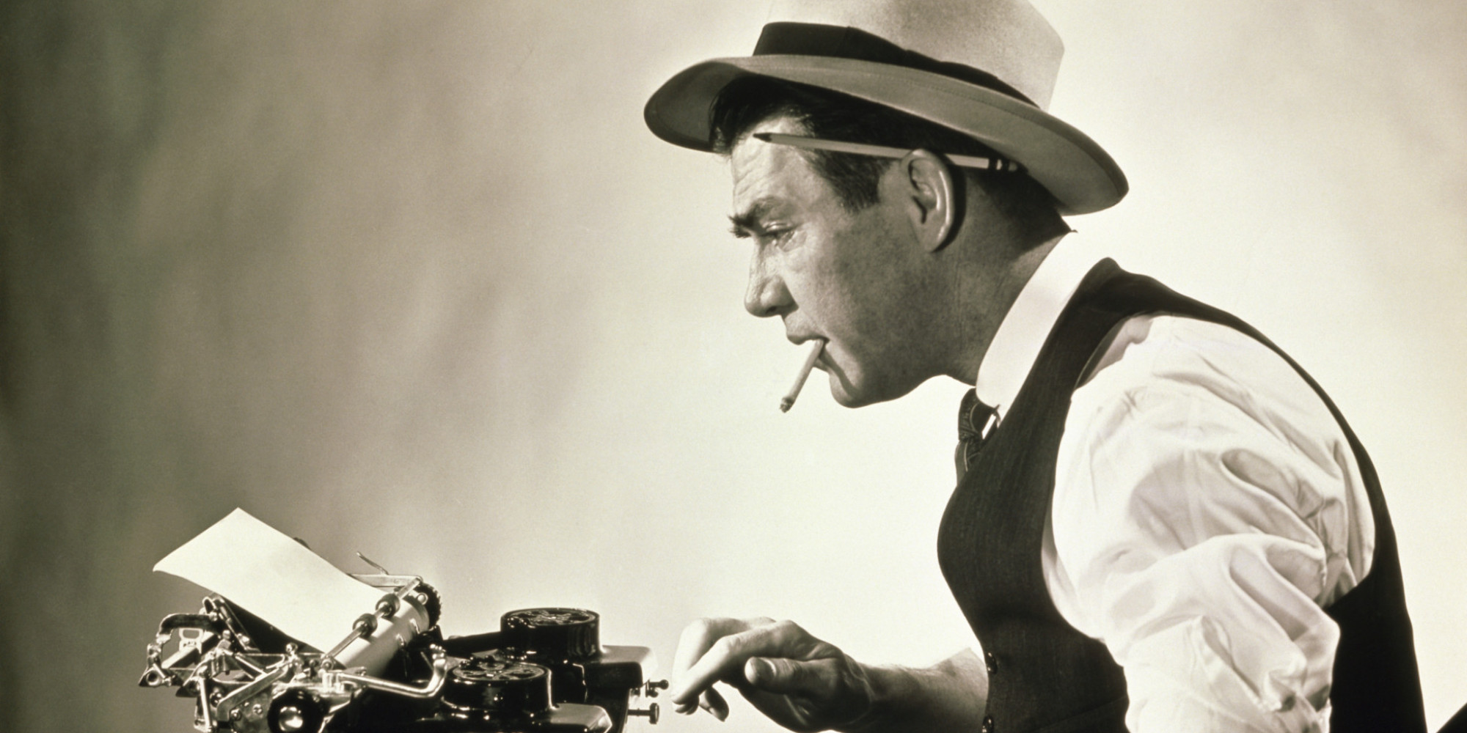
Positions Cont.
Humans of DVC Editor
Overlooks progress of weekly Humans of DVC section
Gives approval for H of DVC to be submitted to Editor-in-Chief and AEC.
In charge of formatting, printing, and displaying each H of DVC section
DVC News and Events Editor
Edits and provides feedback for every article that pertains to DVC news and events.
Gives approval for articles to be submitted to Editor-in-Chief and AEC
Updates news team on upcoming events.
Assigns journalists to cover event
Student Choice Editor
Updates news team on current events (local, national, and world).
Updates current event section on journalism wall
Provides honest feedback on journalists’ pitches.
Gives approval for articles to be submitted to Editor-in-Chief and AEC

Slide 7
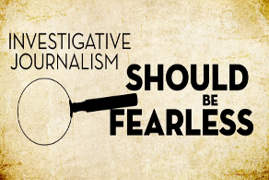
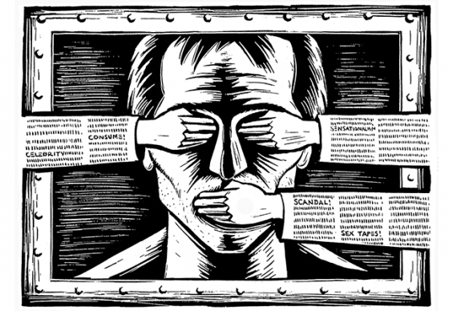
Positions cont.
Journalists
Every person on News Team, including Editors and Web Designers
Gather information on topics/subject that interest you
Investigate topic/subject
Disclose information to the public!
Give people the truth!

