Slide 1

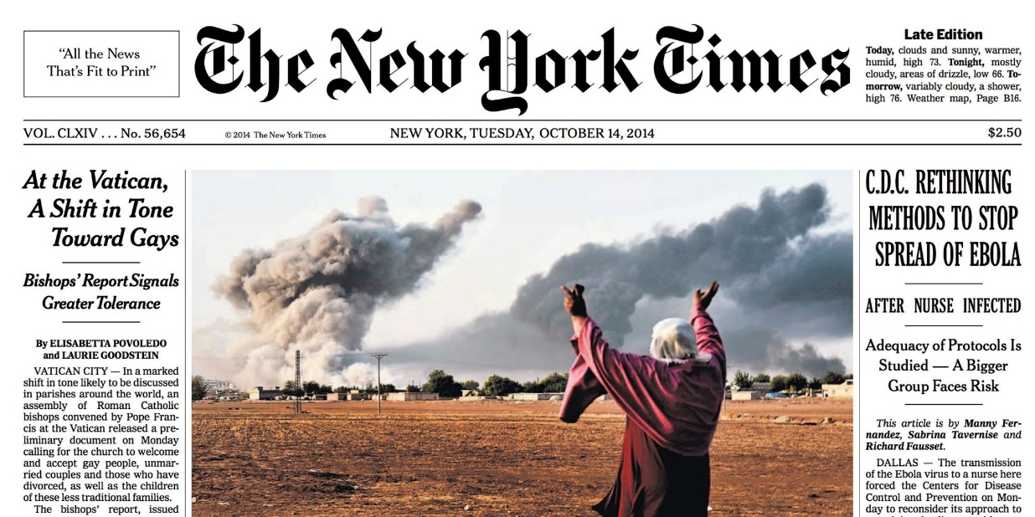

Intro to Journalism
We want the truth!

Slide 2
1) Why is journalism important for our society?
2) In what ways can journalism negatively affect society?
Driving Questions

Slide 3
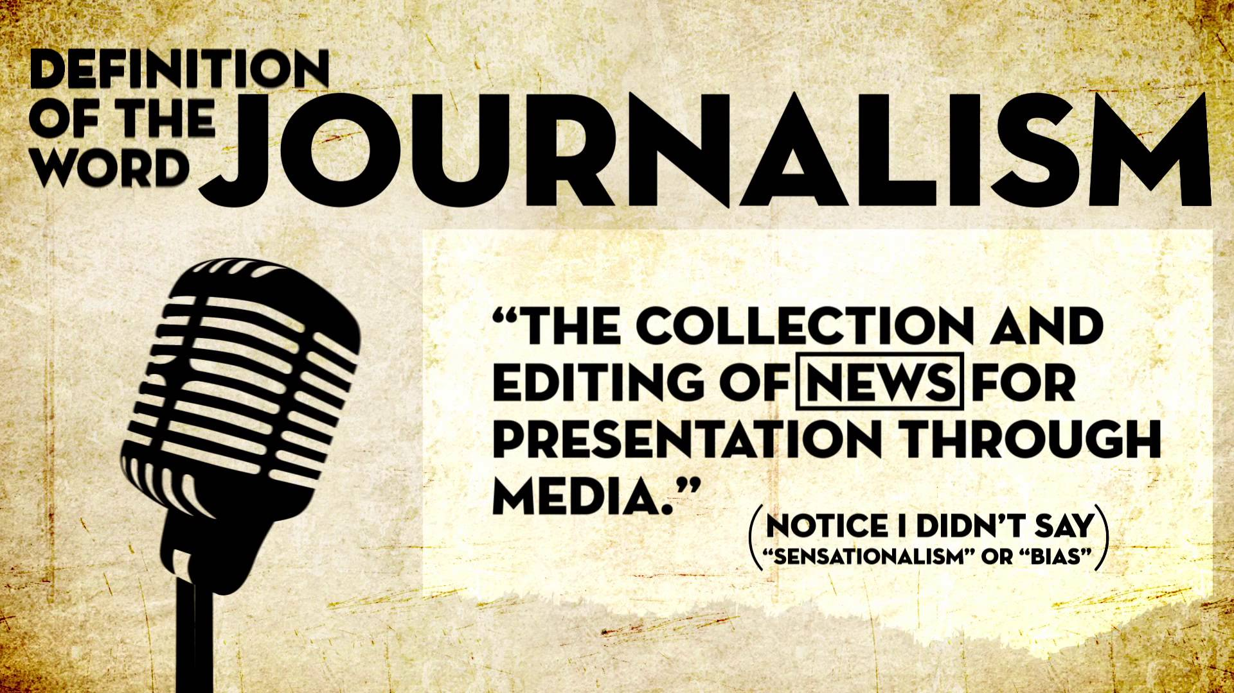

Slide 4
What are 3 things that come to mind when you think of the word “journalism”?

Slide 5
Video
https://www.youtube.com/watch?v=adr2-LChEAY

Slide 6
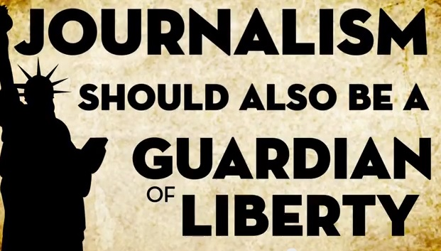
What is News
An account of an event, or a fact or an opinion that interests people.
A presentation of current events.
Intended to inform society about itself.
Make events public that would otherwise remain private.

Slide 7
Types of Articles for Project
Hard News
Feature
Opinion

Slide 8
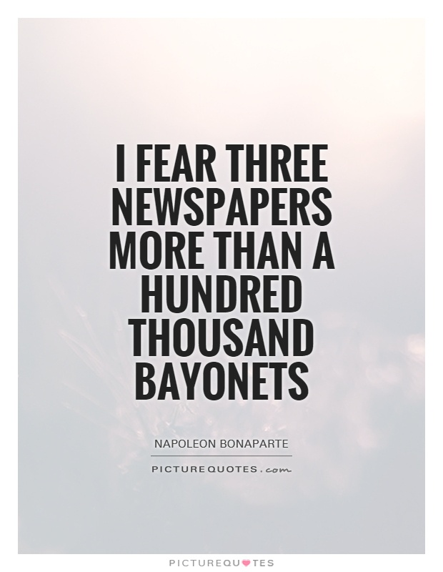
Hard News
Un-bias article that states facts.
Explains why something happened and long term effects.
Exposes the truth without telling the reader what to think.
Part of investigative journalism

Slide 9
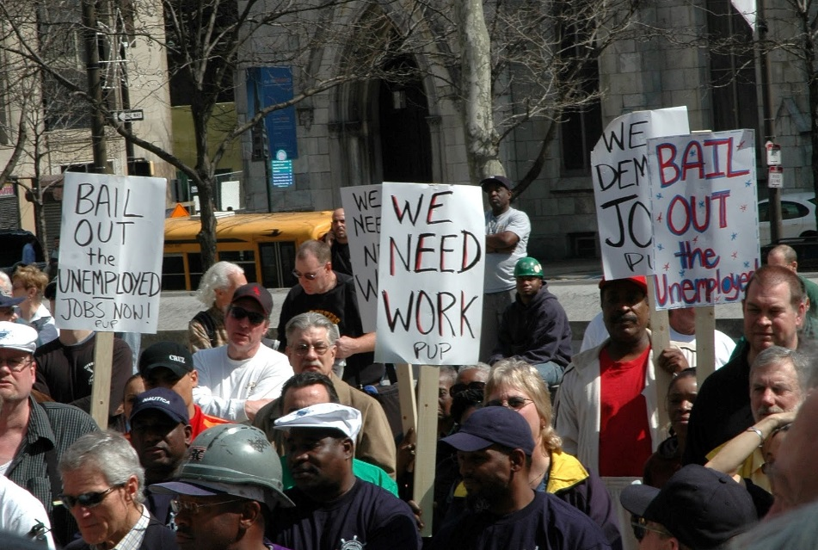
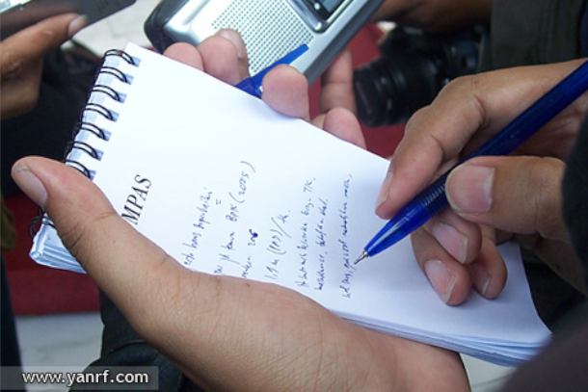
Feature article
longer and more in depth than regular news articles. They cover one subject from multiple angles and are written in a more creative, entertaining format.
Focus on the human element not event(s)
Requires longer and more in-depth interviews
EX: If a hard news story recounts how 1,000 people are being laid off from a local factory, a feature story might focus on just one of those workers, portraying their grief at losing their job

Slide 10
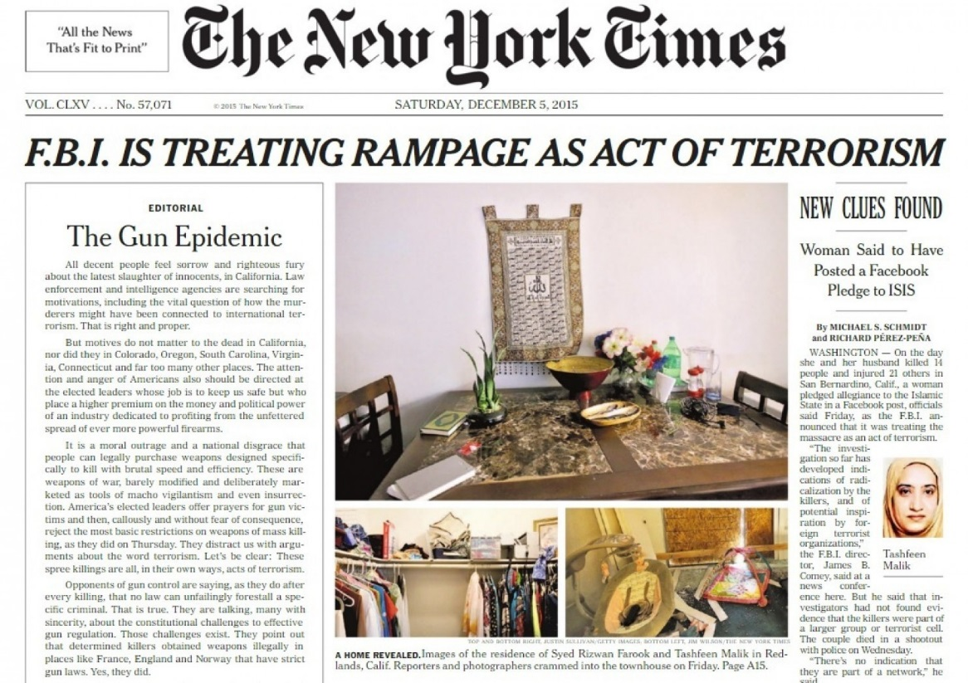
Opinion Article
The writer’s opinion on a particular topic, event, or issue.
Discusses opposing points of views and “squashes” them.
Prove your position with supporting details and evidence.
Draw a conclusion: tell the reader what he/she can do. Provide a solution.
EX: A journalist writes an opinion article about the need for stricter gun laws after a mass shooting.

Slide 11

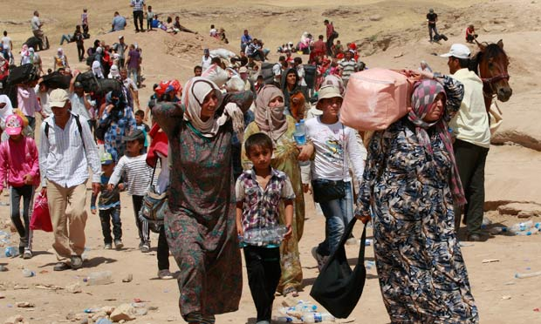
Syrian Refugees
Hard News
Feature
Opinion
More than 1 million refugees and migrants entered Europe by sea. Almost 4,000 died trying.
Story about Syrian refugee and her/his journey, or current state of a country or city that has accepted refugees.
Why United States should accept refugees when the opposing opinion fears terrorism

Slide 12
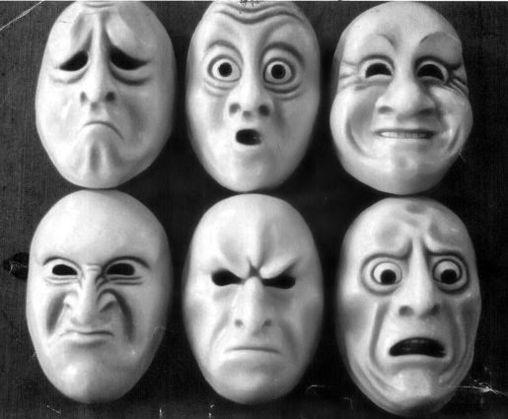
Know Your Audience
Human Interest: If the story evokes (inspires) emotion in the reader such as anger, sadness, or happiness, the reader will have a greater connection with the story and the story will have a greater impact.
You are writing for the Da Vinci community, so choose topics/subjects that will interest your audience

Slide 13
Let’s Brainstorm!

