Slide 1
Imagery

Slide 2
What is Imagery
Words and phrases to describe a place, person, or event in such a manner that the reader feels as if s/he is experiencing the place, person, or event first hand.
Using specific words that can be felt by our five senses. These help a reader mentally live through what the characters in the book are actually experiencing.

Slide 3
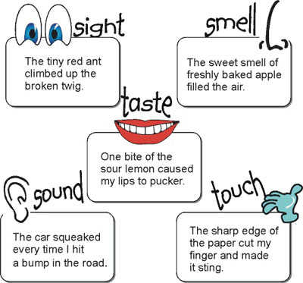
Why is Imagery Important?
Helps a reader mentally live through what the characters in the book are actually experiencing.
The author is painting a picture in the readers mind.

Slide 4
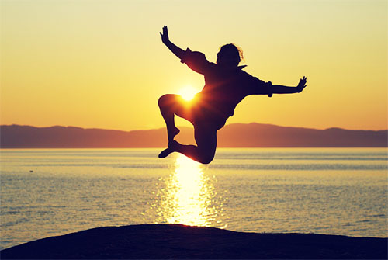
Example: A walk during a summer night
Sight - a full moon in a black sky and planes taking off from LAX Sound – ocean waves crashing Taste - the tang of a cold glass of lemonade Touch - a warm breeze and sand under my feet. Smell – fresh ocean air mixed with funky smell from water treatment plant.

Slide 5
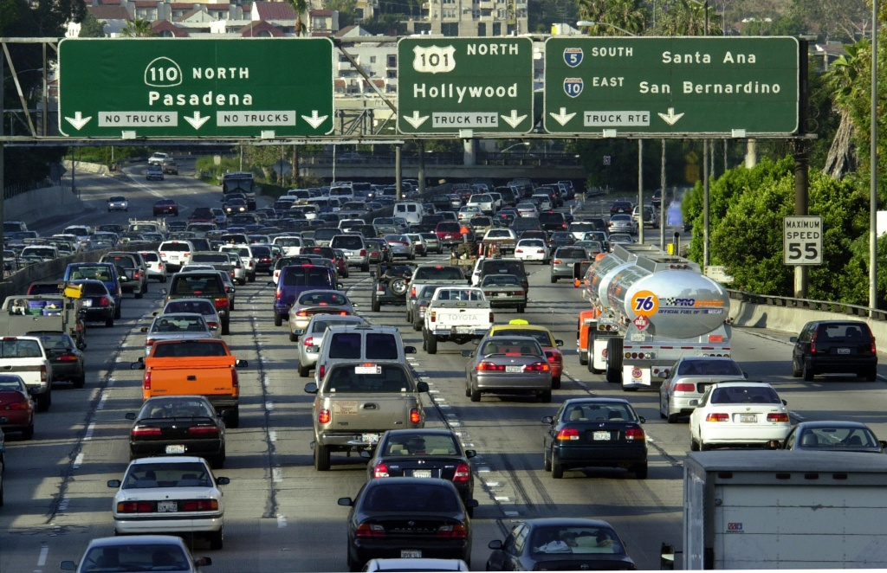
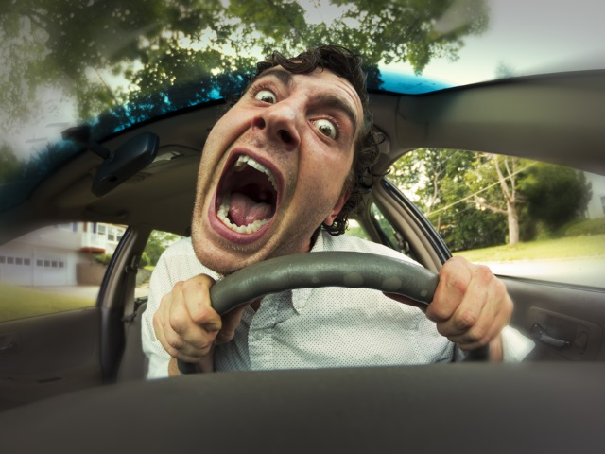
Example 2: Stuck in LA Traffic

Slide 6
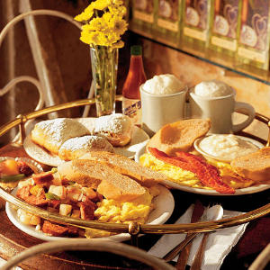
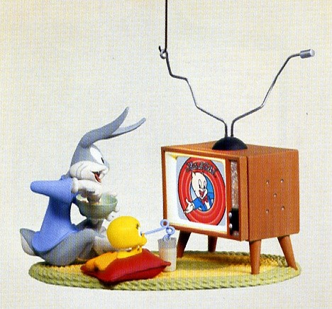
Your Turn!
Using your graphic organizer, imagine the perfect Saturday morning. Describe it using the five senses on your graphic organizer.
Sight
Sound
Taste
Touch
Smell

Slide 7
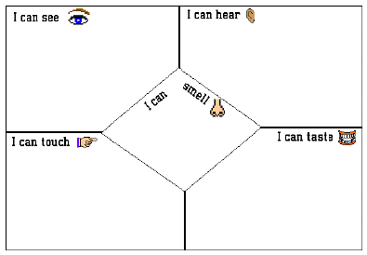

Slide 8
One more time!
Close your eyes and wait for Mr. E to tell you when to open them again.
Trust me!
When you open your eyes, share out what you saw, tasted, smelled, felt (touched), and heard.

