Slide 1
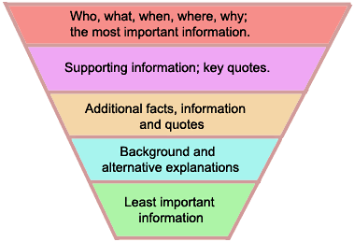
Inverted Pyramid

Slide 2
Lead Paragraph
Hard News: Provide the most important information: who, what, when, where, why, and how.
Opinion: Sentence/paragraph in which you introduce your topic and why it’s important.
Feature: It’s a story, so be sure to grab the reader’s attention.
Anecdotes (brief story)
Vignettes (vivid description of the setting, sensory details)
Quotes - from authorities
Familiar sayings or play on words that connects to the reader
Surprising statistics or facts
An unusual statement

Slide 3
Newswriting vs Essays
Newswriting is traditionally arranged in an inverted pyramid.
The first paragraph is the lead -- with 5Ws and H.
A summary lead is usually one sentence.
Additional paragraphs are short and contain less and less important information.
Essays traditionally are five paragraphs.
The first paragraph is the introduction and thesis statement.
Second, third and fourth paragraphs develop the topic using
Compare and contrast
Definition
Classification, etc.
The final paragraph is the conclusion.

