Slide 1
Designing and creating a Non-profit

Slide 2
Where do we start?
Today
In the coming days/weeks
Choose a name
Come up with a slogan
Brainstorm your organizations brand/image
Colors
Brainstorm Logo
Brainstorm media strategy
Draft a MISSION STATEMENT
Finalize Mission Statement
Gather data that will drive your mission
Core Values
Create booth that will attract potential donors

Slide 3
Slogan
Google definition: a short and striking or memorable phrase used in advertising.
Examples:
Wounded Warrior Project: The most important casualty is being forgotten
TED: Ideas worth Spreading
Stand Up To Cancer: This is where the end of cancer begins

Slide 4
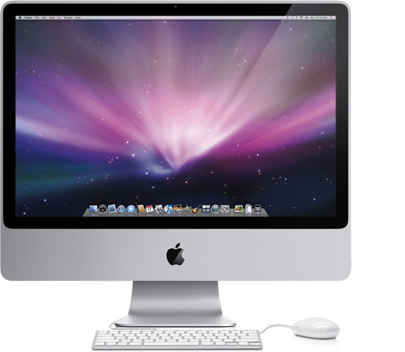
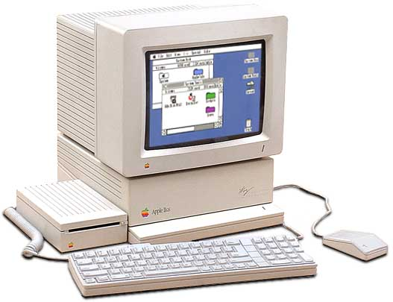
Brand and Image
How do you want your organization to appear to the public?
i.e. Professional, edgy, fun, controversial, dark, etc.
Colors: Although it may sound silly, your colors are very important. They should connect with the image you want to convey.
Logo: Connecting to your branding, and colors, create a logo that will attract consumers/donors.
Apple’s new image that
led to its current success.
Simple and sexy!
Apple’s image when
it was on verge
of bankruptcy

Slide 5
What is a Mission Statement
Every business needs a purpose that delineates what it is and a vision that describes what it wants to be.
This purpose and vision come together in the mission statement.
A mission statement is a declaration of what a business aspires to be.
The statement is the business’s reason for being, a proclamation of why it exists, a clarification of who it serves, and an expression of what it hopes to achieve in the future.
A carefully crafted mission statement accurately describes the business and inspires the people who contribute to its success.

Slide 6
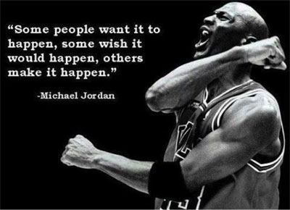
Mission Statement
Are…
Do not…
Visionary
short and concise: no more than a paragraph.
memorable
realistic
easy to understand
motivational / inspiring
full of high-impact and precise verbs
have a call to action
focus on facts about an issue

Slide 7
Non-profit examples
Human rights watch
https://www.hrw.org/about
UNICEF
http://www.unicef.org/about/who/index_mission.html
Greenpeace
http://www.greenpeace.org/international/en/about/our-core-values/
Stand Up to Cancer
https://www.standup2cancer.org/mission_statement

Slide 8
Core Values
Google definition:
Core values are the fundamental beliefs of a person or organization. The core values are the guiding principles that dictate behavior and action.

Slide 9
Core Values
Do…
Are not…
Guide business processes
Clarify who you are
Articulate what we stand for
Require no external justification
Help explain why we do business the way we do
Operating practices
Business strategies
Cultural norms

Slide 10
Examples of Core Values
Dependable
Reliable
Loyal
Committed
Open-minded
Honest
Innovative
Adventurous
Motivated
Optimistic
Passionate
Courageous
Educated
Loving
Nurturing
Creative

